Slide 1
Introduction to Probability and Statistics
4CM521
Random Variables, expected values and probability distributions

Slide 2
Introduction
Random variables map possible outcomes to numerical values.
Expected value is a measure representing the average of potential outcomes.
Probability distributions present mathematical structure that quantify the likelihood of different outcomes for a given random variable.

Slide 3
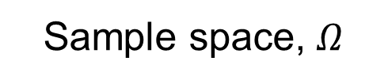
Introduction (continued)
Sample space, $Ω$
Random Variable
Probability
Heads
0
1/2
Tails
1

Slide 4
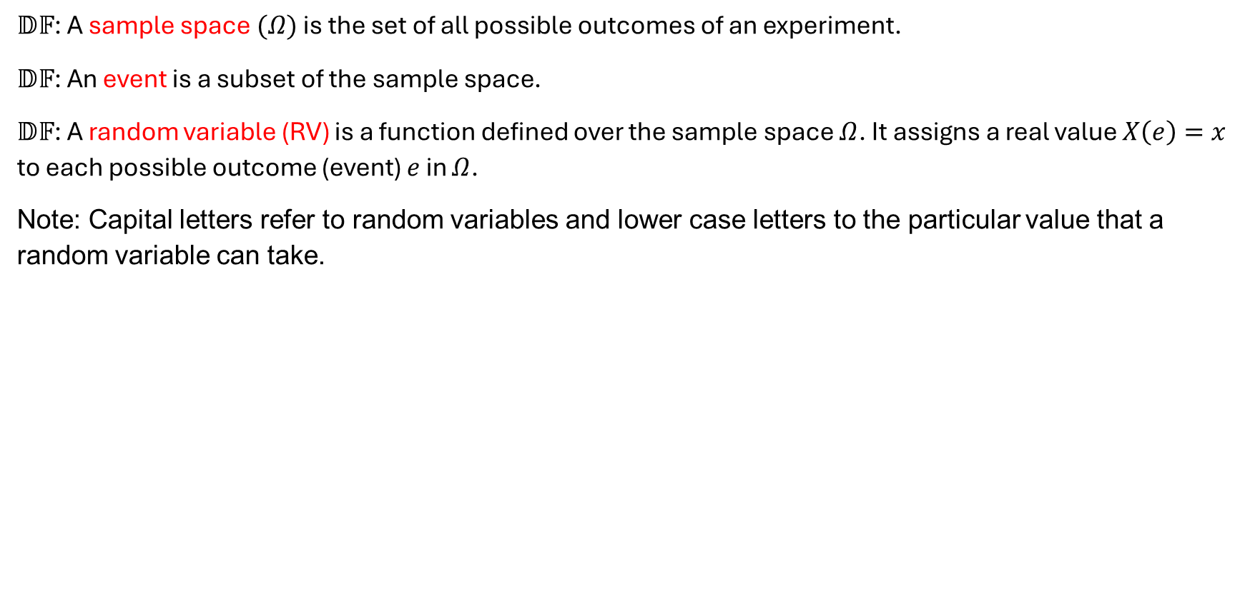
Basic Notation and Principles
$𝔻𝔽$: A sample space $(Ω)$ is the set of all possible outcomes of an experiment.
$𝔻𝔽$: An event is a subset of the sample space.
$𝔻𝔽$: A random variable (RV) is a function defined over the sample space $Ω$. It assigns a real value $X\left(e\right)=x$ to each possible outcome (event) $e$ in $Ω$.
Note: Capital letters refer to random variables and lower case letters to the particular value that a random variable can take.

Slide 5
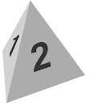
Example 6.1
Consider throwing two tetrahedral dice (or two throws of a single tetrahedral die) and consider the following random variables all involving the face on which the dice land. The various outcomes are:
Value on first face, value on second face |  | Value on second face
 |  | 1 | 2 | 3 | 4
Value on first face | 1 | (1,1) | (1,2) | (1,3) | (1,4)
 | 2 | (2,1) | (2,2) | (2,3) | (2,4)
 | 3 | (3,1) | (3,2) | (3,3) | (3,4)
 | 4 | (4,1) | (4,2) | (4,3) | (4,4)

Slide 6
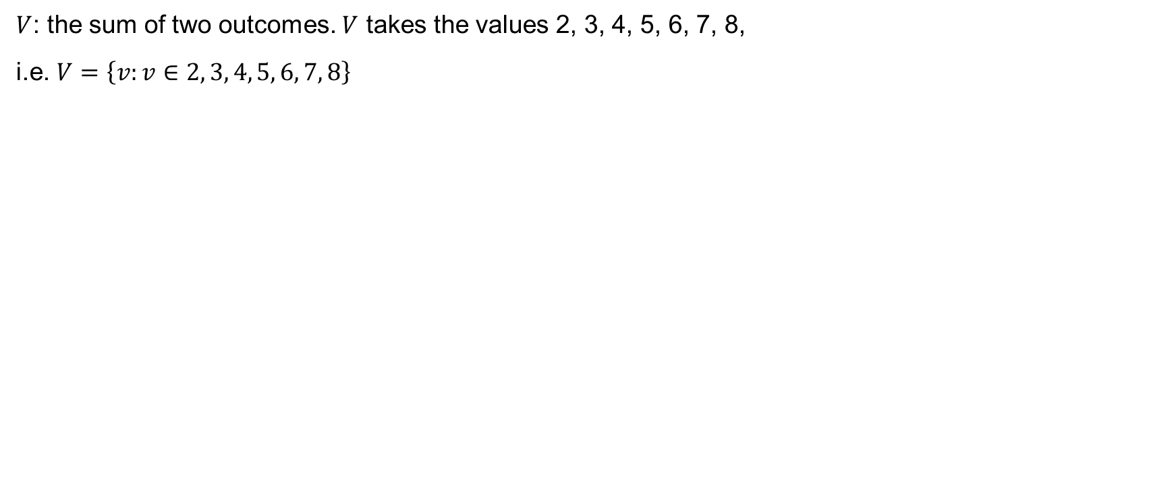
Other examples
$V$: the sum of two outcomes. $V$ takes the values 2, 3, 4, 5, 6, 7, 8,
i.e. $V=\left\{v:v∈2, 3, 4, 5, 6, 7, 8\right\}$

Slide 7
Your turn

Slide 8
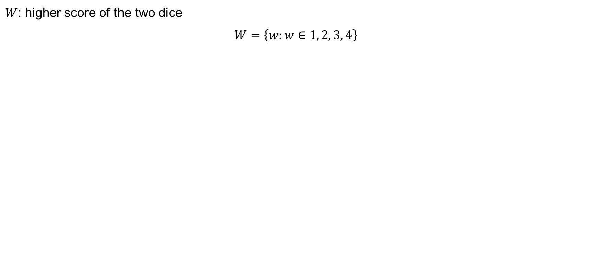
Other examples (continued)
$W$: higher score of the two dice
$$W=\left\{w:w∈1, 2, 3, 4\right\}$$

Slide 9
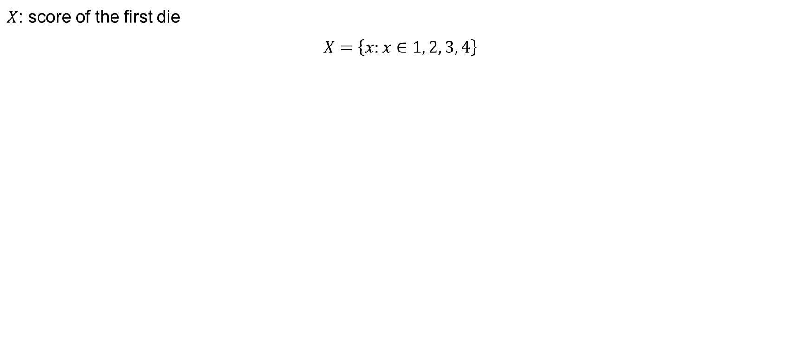
Other examples (continued)
$X$: score of the first die
$$X=\left\{x:x∈1, 2, 3, 4\right\}$$

Slide 10
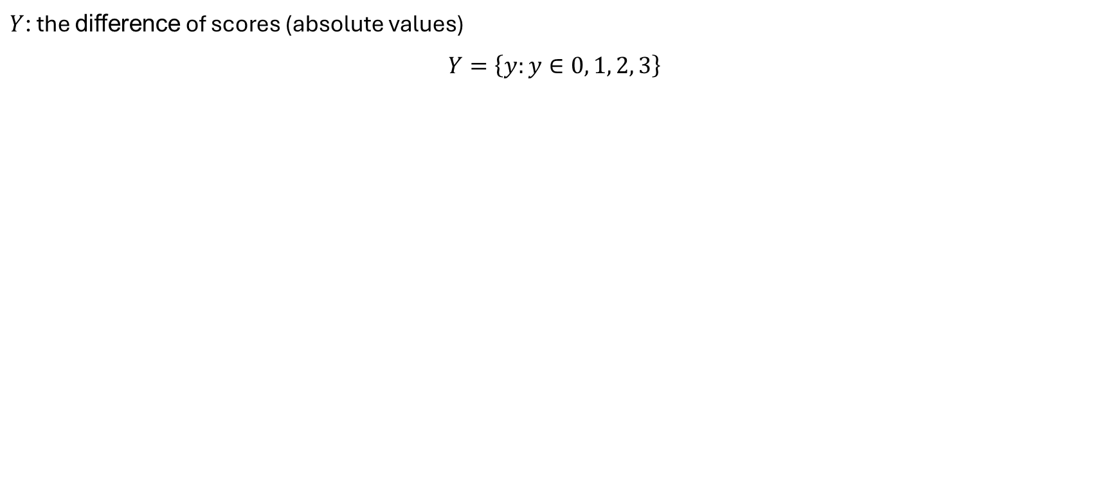
Other examples (continued)
$Y$: the difference of scores (absolute values)
$$Y=\left\{y:y∈0, 1, 2, 3\right\}$$

Slide 11
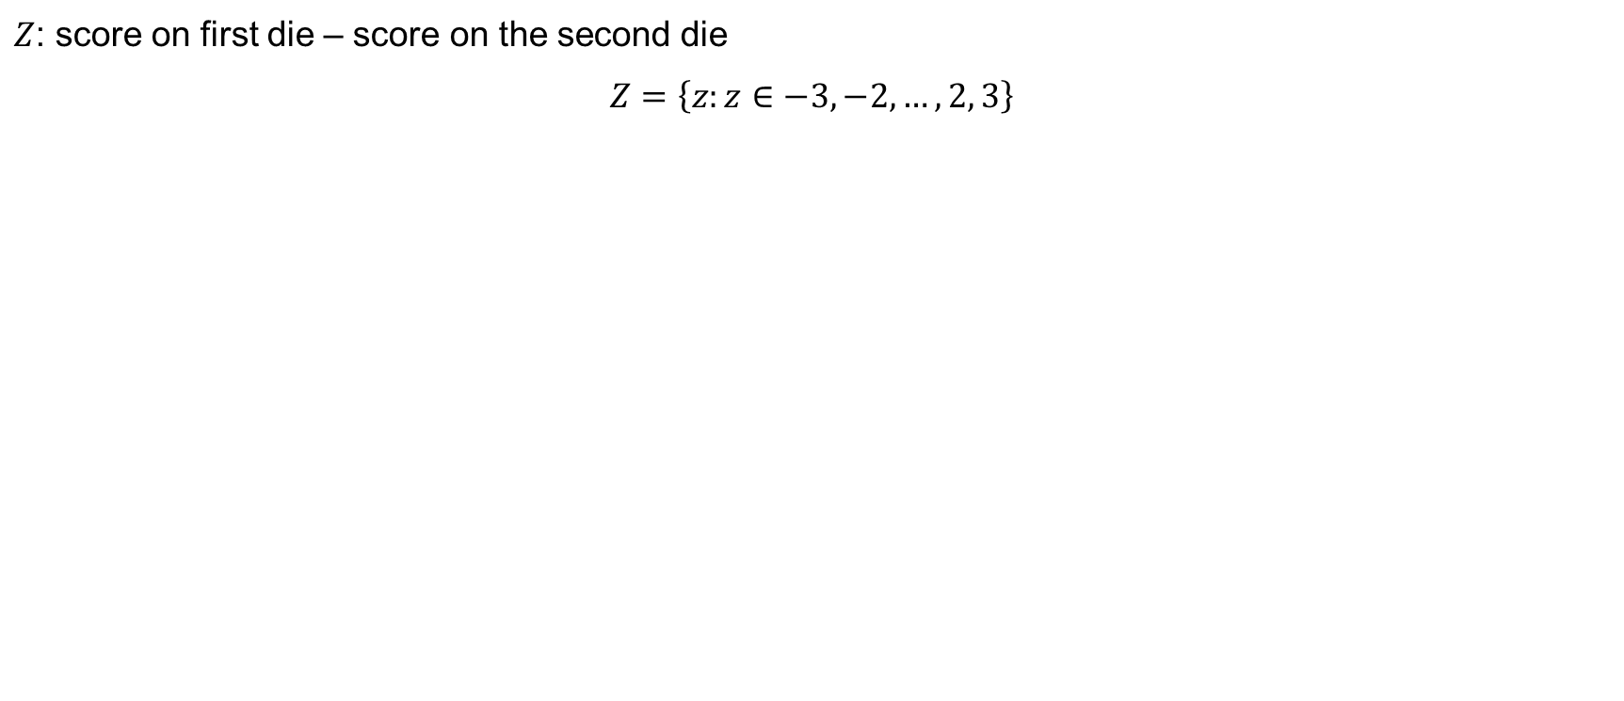
Other examples (continued)
$Z$: score on first die – score on the second die
$$Z=\left\{z:z∈−3,−2,…,2, 3\right\}$$

Slide 12
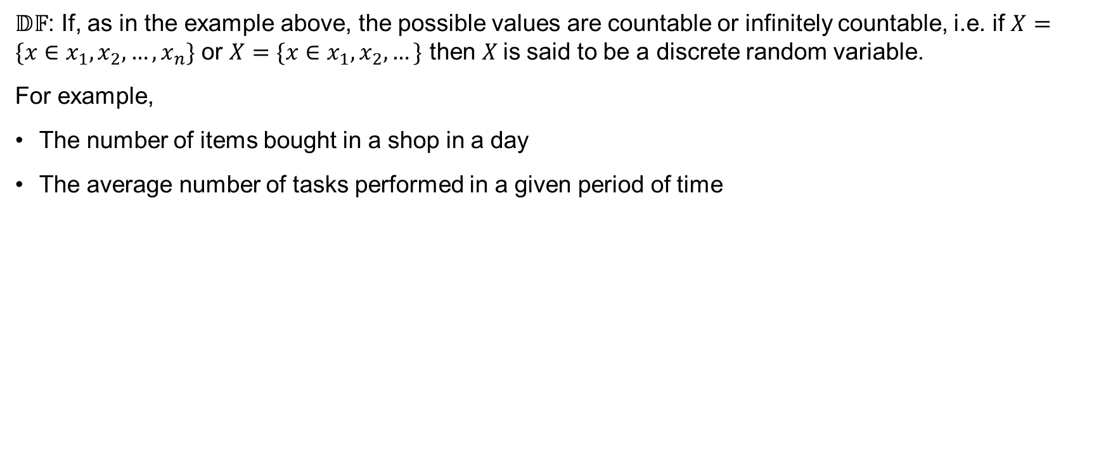
Discrete Random Variables
$𝔻𝔽$: If, as in the example above, the possible values are countable or infinitely countable, i.e. if $X=\{x∈x_{1},x_{2},…,x_{n}\}$ or $X=\{x∈x_{1},x_{2},…\}$ then $X$is said to be a discrete random variable.
For example,
The number of items bought in a shop in a day
The average number of tasks performed in a given period of time

Slide 13
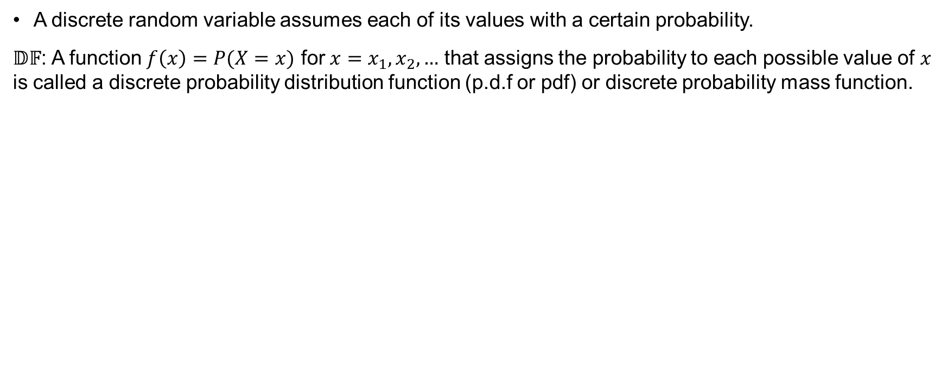
Probability Distribution Function (Discrete Case)
A discrete random variable assumes each of its values with a certain probability.
$𝔻𝔽$: A function $f\left(x\right)=P(X=x)$ for $x=x_{1}, x_{2},…$ that assigns the probability to each possible value of $x$ is called a discrete probability distribution function (p.d.f or pdf) or discrete probability mass function.

Slide 14
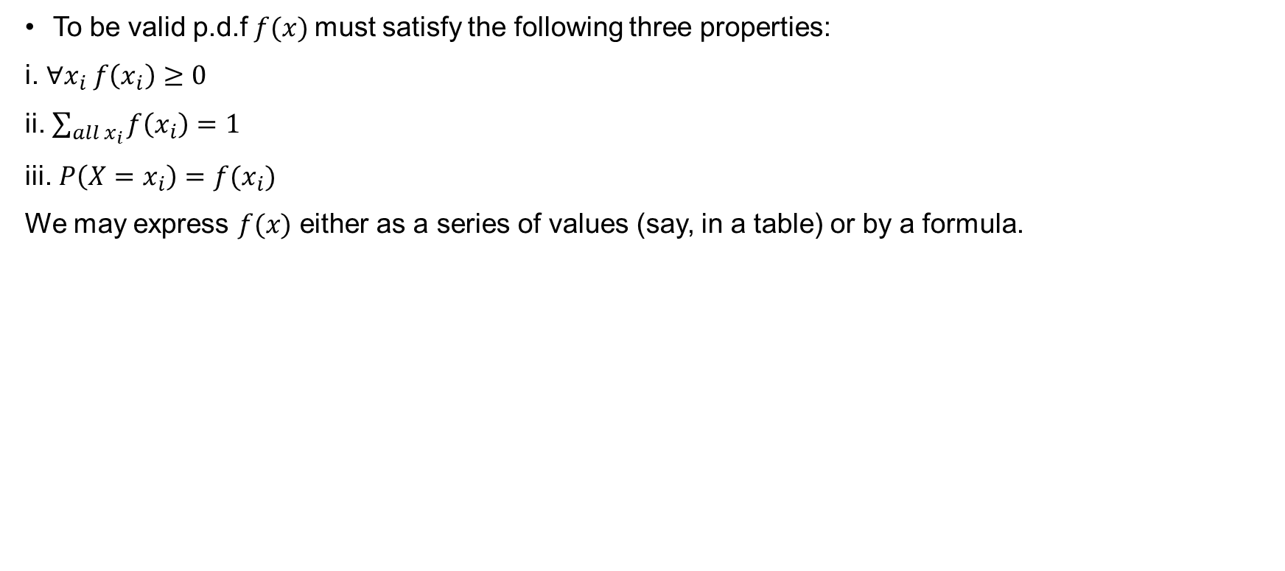
Properties of a p.d.f
To be valid p.d.f $f(x)$must satisfy the following three properties:
i. $∀x_{i} f\left(x_{i}\right)≥0$
ii. $\sum_{all x_{i}}{f\left(x_{i}\right)=1}$
iii. $P\left(X=x_{i}\right)=f(x_{i})$
We may express $f(x)$ either as a series of values (say, in a table) or by a formula.

Slide 15
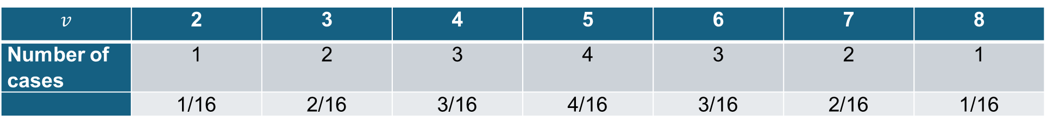

Example 6.2
We return to Example 6.1 and consider the random variable $V$ (i.e. $V$: the sum of two outcomes. $V$ takes the values 2, 3, 4, 5, 6, 7, 8, i.e. $V=\left\{v:v∈2, 3, 4, 5, 6, 7, 8\right\}$)
$$v$$ | 2 | 3 | 4 | 5 | 6 | 7 | 8
Number of cases | 1 | 2 | 3 | 4 | 3 | 2 | 1
 | 1/16 | 2/16 | 3/16 | 4/16 | 3/16 | 2/16 | 1/16

Slide 16

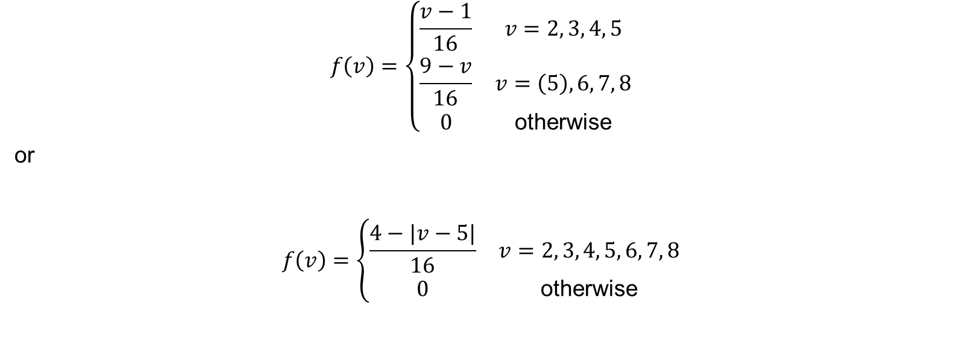
Alternatively, we can write
$$f\left(v\right)=\left\{\begin{matrix}\frac{v−1}{16} & v=2, 3, 4, 5 \\ \frac{9−v}{16} & v=\left(5\right), 6, 7, 8 \\ 0 & \text{otherwise}\end{matrix}\right.$$
or
$$f\left(v\right)=\left\{\begin{matrix}\frac{4−|v−5|}{16} & v=2, 3, 4, 5, 6, 7, 8 \\ 0 & \text{otherwise}\end{matrix}\right.$$
Task: Substitute some values of $v$ and convince yourself that both versions of $f\left(v\right)$ are correct.

Slide 17
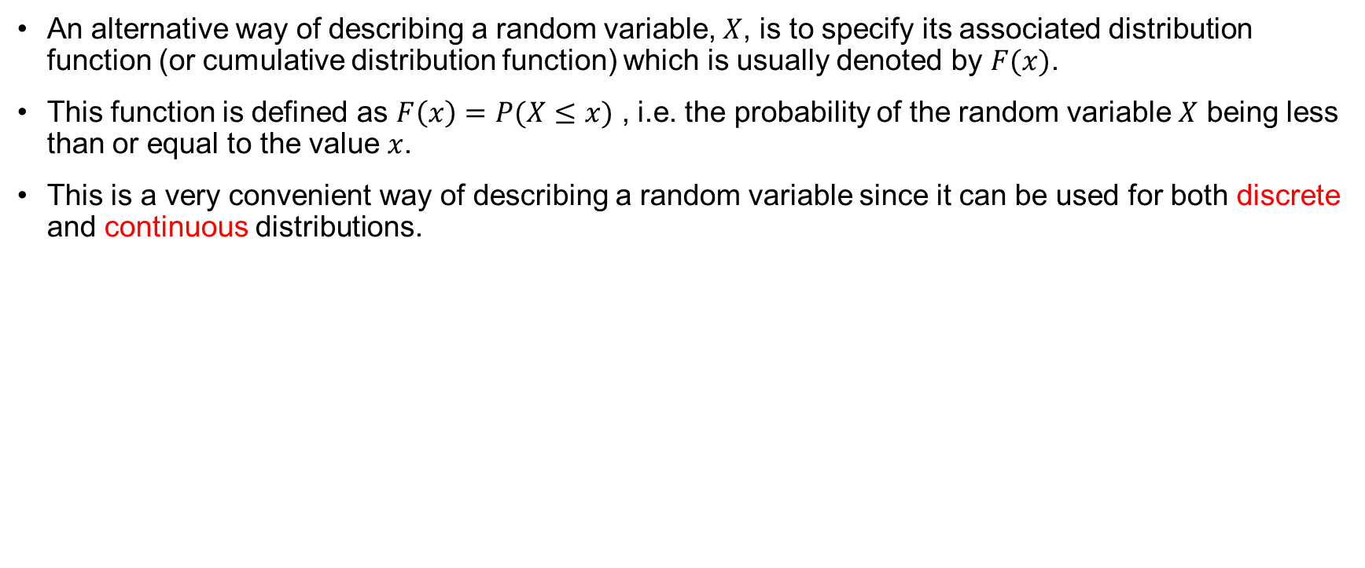
Cumulative Distribution Function (c.d.f)
An alternative way of describing a random variable, $X$, is to specify its associated distribution function (or cumulative distribution function) which is usually denoted by $F(x)$.
This function is defined as $F\left(x\right)=P(X≤x)$ , i.e. the probability of the random variable $X$ being less than or equal to the value $x$.
This is a very convenient way of describing a random variable since it can be used for both discrete and continuous distributions.

Slide 18
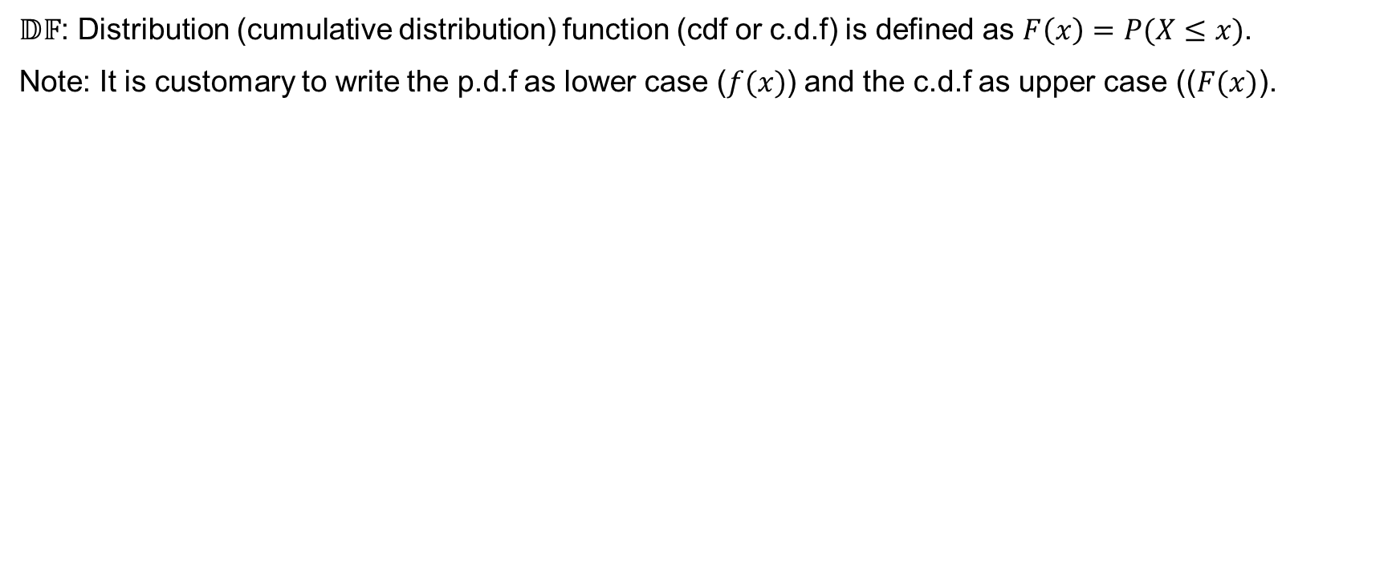
Definition of c.d.f
$𝔻𝔽$: Distribution (cumulative distribution) function (cdf or c.d.f) is defined as $F\left(x\right)=P(X≤x)$.
Note: It is customary to write the p.d.f as lower case ($f(x)$) and the c.d.f as upper case (($F(x)$).

Slide 19
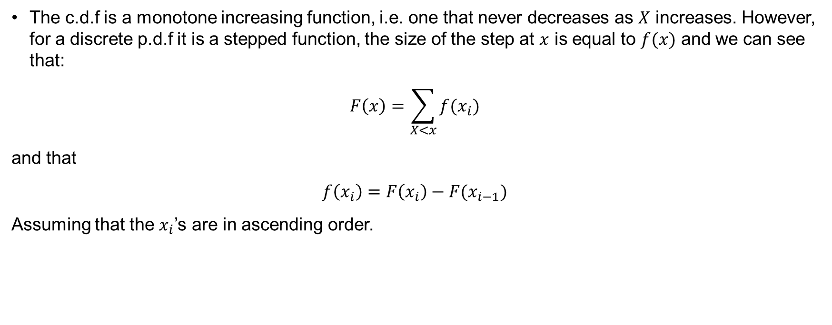
c.d.f
The c.d.f is a monotone increasing function, i.e. one that never decreases as $X$ increases. However, for a discrete p.d.f it is a stepped function, the size of the step at $x$ is equal to $f(x)$ and we can see that:
$$F\left(x\right)=\sum_{X<x}{f(x_{i})}$$
and that
$$f\left(x_{i}\right)=F\left(x_{i}\right)−F(x_{i−1})$$
Assuming that the $x_{i}$’s are in ascending order.

Slide 20
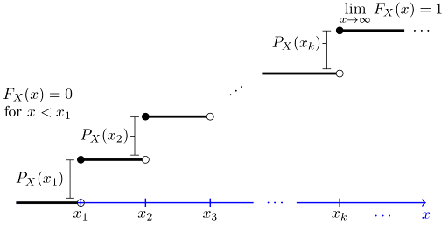
c.d.f(continued)

Slide 21
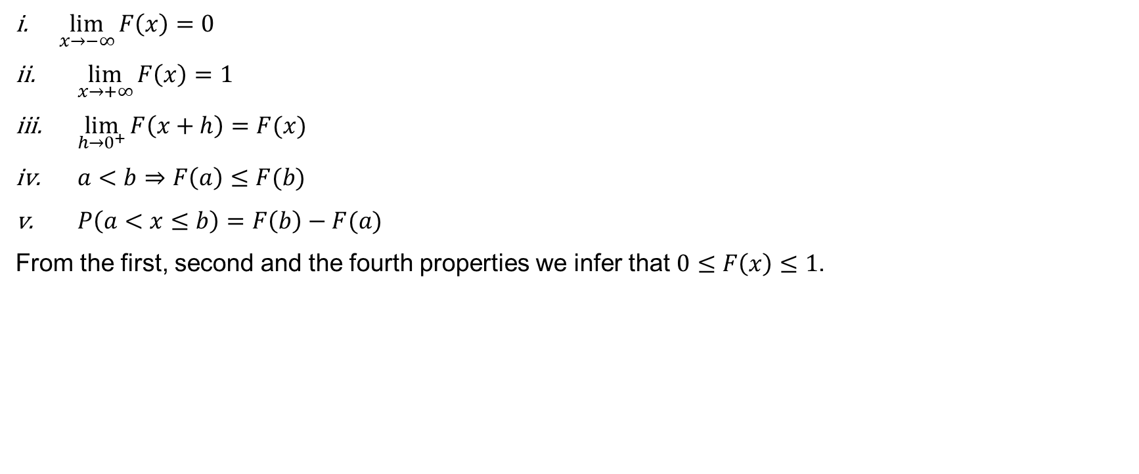
Properties of c.d.f
$\lim_{x→−∞}{F\left(x\right)=0}$
$\lim_{x→+∞}{F\left(x\right)=1}$
$\lim_{h→0^{+}}{F\left(x+h\right)=F(x)}$
$a<b⇒F\left(a\right)≤F(b)$
$P\left(a<x≤b\right)=F\left(b\right)−F(a)$
From the first, second and the fourth properties we infer that $0≤F\left(x\right)≤1$.

Slide 22

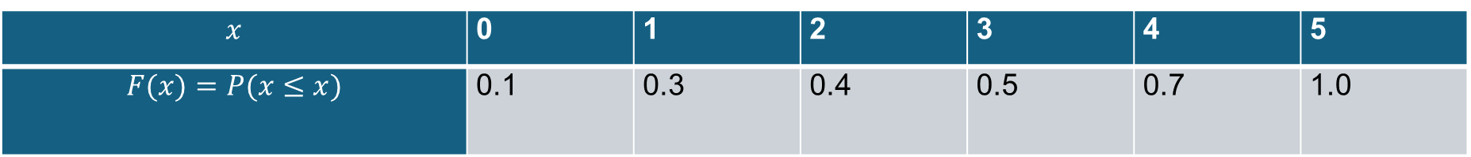
Example 6.3
If we have the following discrete distribution:
$$x$$ | 0 | 1 | 2 | 3 | 4 | 5
$$P(X=x)$$ | 0.1 | 0.2 | 0.1 | 0.1 | 0.2 | 0.3
then we can compute the following cumulative properties in order to obtain the distribution function
$$x$$ | 0 | 1 | 2 | 3 | 4 | 5
$$F(x)=P(x≤x)$$ | 0.1 | 0.3 | 0.4 | 0.5 | 0.7 | 1.0
and the cumulative distribution function $F(x)$, is a step-function

Slide 23
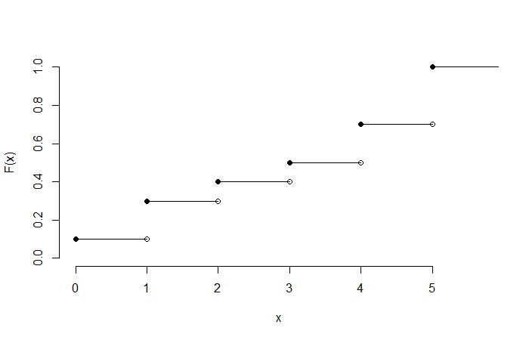
Example 6.3 (continued)

Slide 24
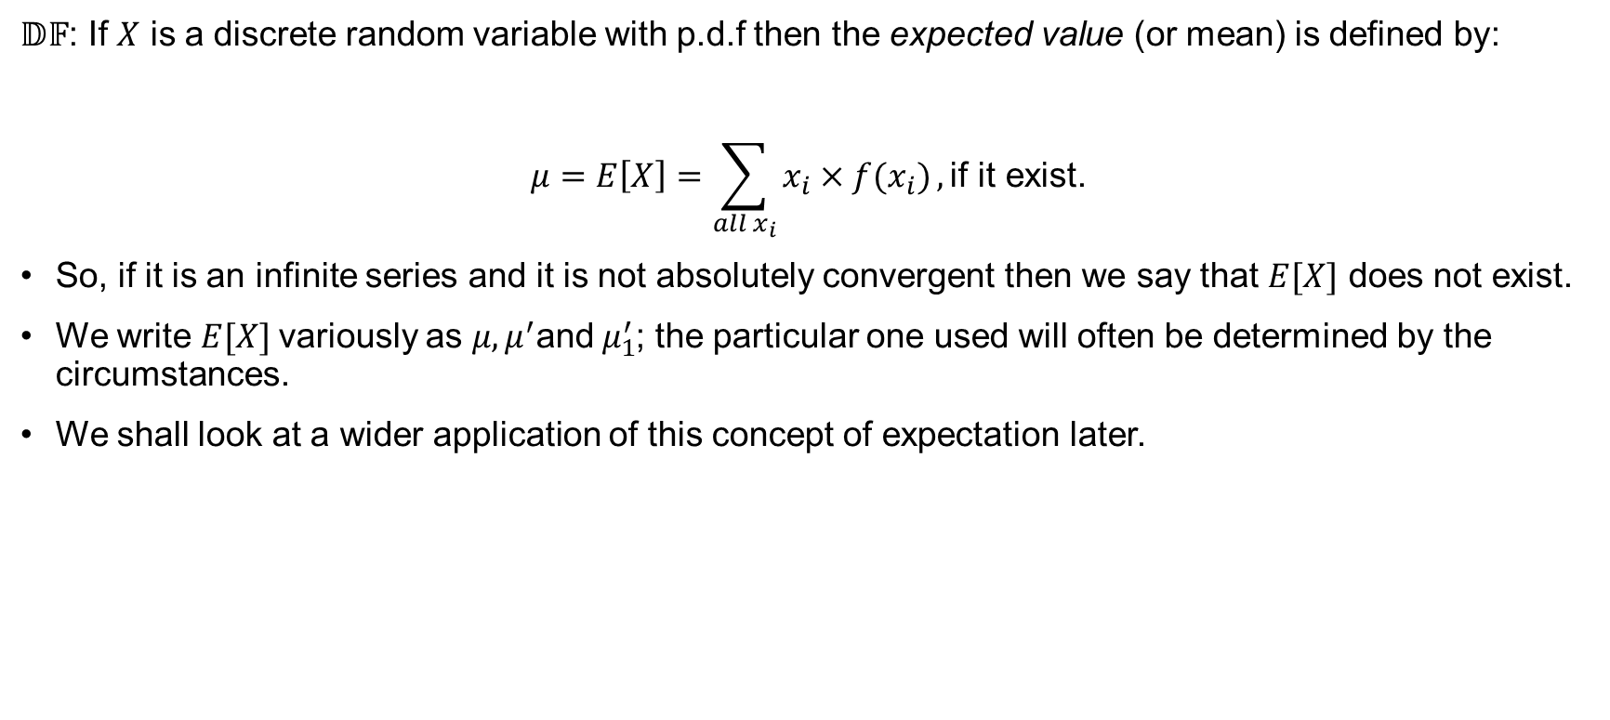
Mean or expected value (Discrete Case)
$𝔻𝔽$: If $X$ is a discrete random variable with p.d.f then the expected value (or mean) is defined by:
$$μ=E\left[X\right]=\sum_{all x_{i}}{x_{i}×f(x_{i})}, \text{if} \text{it} \text{exist}\text{.}$$
So, if it is an infinite series and it is not absolutely convergent then we say that $E[X]$ does not exist.
We write $E[X]$variously as $μ, μ^{′}\text{and} μ_{1}^{′}$; the particular one used will often be determined by the circumstances.
We shall look at a wider application of this concept of expectation later.

Slide 25
Example 6.4.
Consider the distribution of the higher score of the two tetrahedral dice. What is the mean of this distribution?
Value on first face, value on second face |  | Value on second face
 |  | 1 | 2 | 3 | 4
Value on first face | 1 | (1,1) | (1,2) | (1,3) | (1,4)
 | 2 | (2,1) | (2,2) | (2,3) | (2,4)
 | 3 | (3,1) | (3,2) | (3,3) | (3,4)
 | 4 | (4,1) | (4,2) | (4,3) | (4,4)
$$x$$ | 1 | 2 | 3 | 4
$$f(x)$$ | 1/16 | 3/16 | 5/16 | 7/16

Slide 26
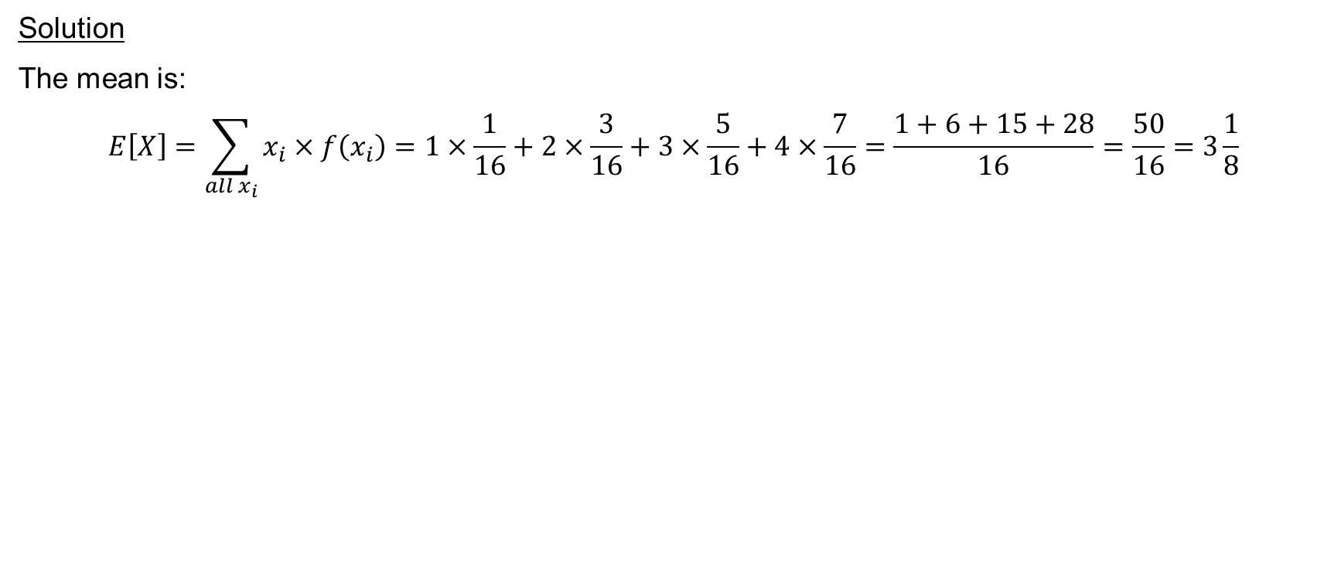
Example 6.4 (continued)
Solution
The mean is:
$$E\left[X\right]=\sum_{all x_{i}}{x_{i}×f\left(x_{i}\right)=1×\frac{1}{16}+2×\frac{3}{16}+3×\frac{5}{16}+4×\frac{7}{16}=\frac{1+6+15+28}{16}=\frac{50}{16}=3\frac{1}{8}}$$

Slide 27
Continuous Random Variables
A continuous random variable has an infinite number of values and it has a probability of 0 of assuming exactly any of its values.
Consequently, its probability distribution cannot be given in tabular form.

Slide 28
Why? Step by step example
Let us consider a random variable whose values are the heights of all people over 21 years of age.
Between any two values, say 164.5 cm and 165.5 cm there are an infinite number of heights, one of which is 165 cm.
The probability of selecting a person with height exactly 165 cm but not one of the infinitely large set of heights so close to 165 is humanly impossible and therefore we assign a probability 0 to the event “165 cm high”.

Slide 29
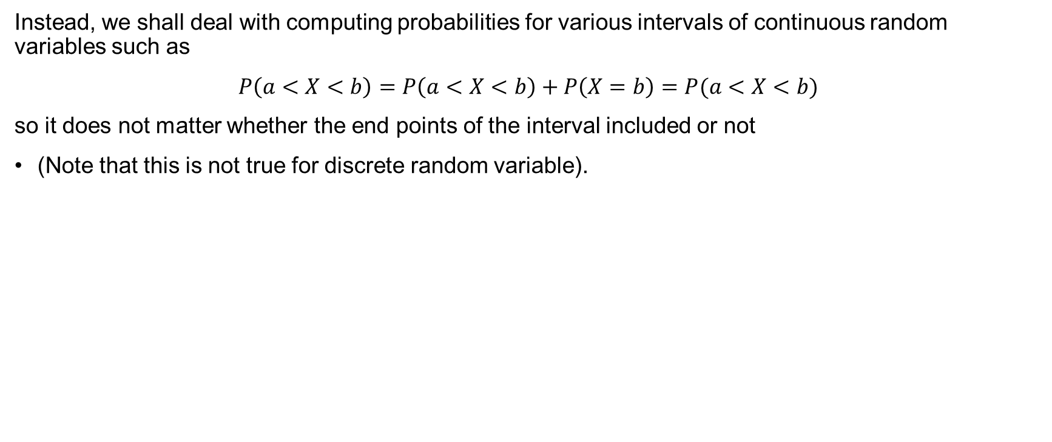
Why? Step by step example (continued)
Instead, we shall deal with computing probabilities for various intervals of continuous random variables such as
$$P\left(a<X<b\right)=P\left(a<X<b\right)+P\left(X=b\right)=P(a<X<b)$$
so it does not matter whether the end points of the interval included or not
(Note that this is not true for discrete random variable).

Slide 30
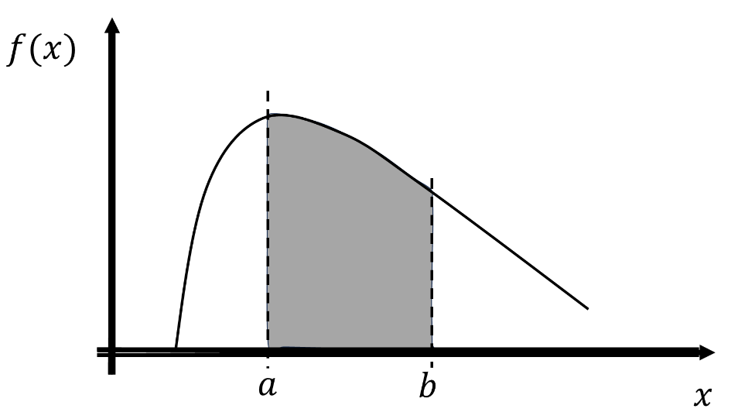
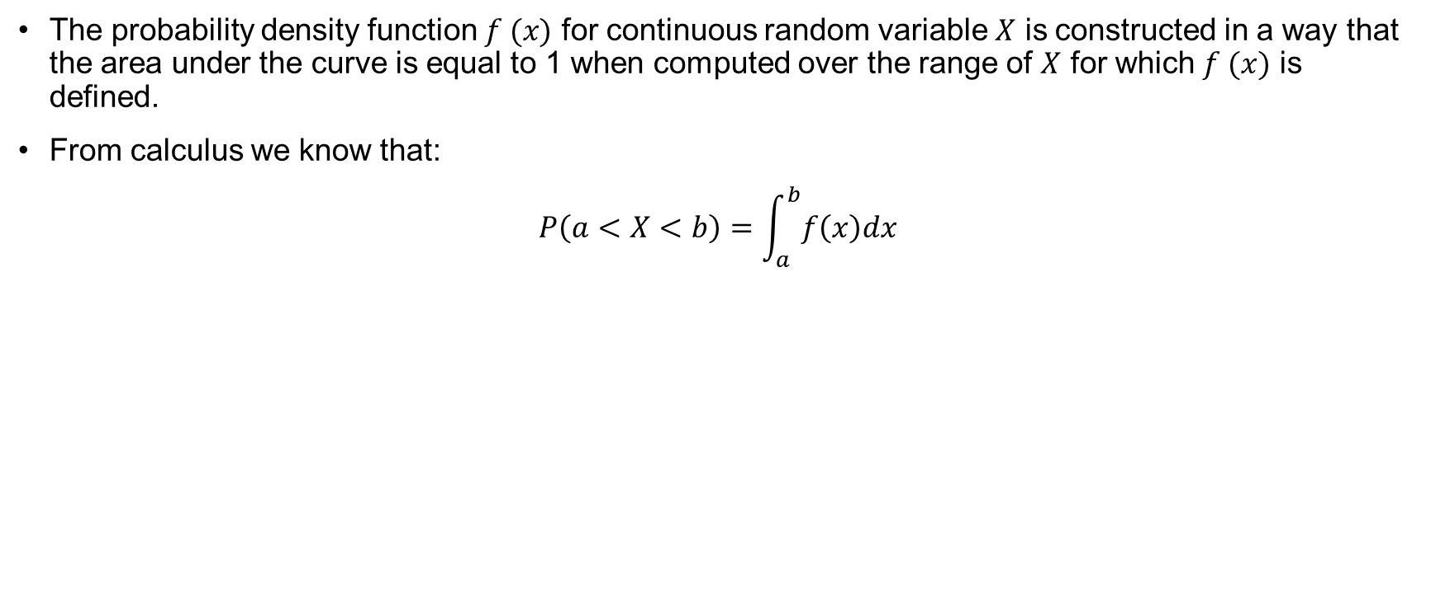
Probability Distribution Function (The continuous case)
The probability density function $f (x)$ for continuous random variable $X$ is constructed in a way that the area under the curve is equal to 1 when computed over the range of $X$ for which $f (x)$ is defined.
From calculus we know that:
$$P\left(a<X<b\right)=\int_{a}^{b}{f\left(x\right)dx}$$

Slide 31
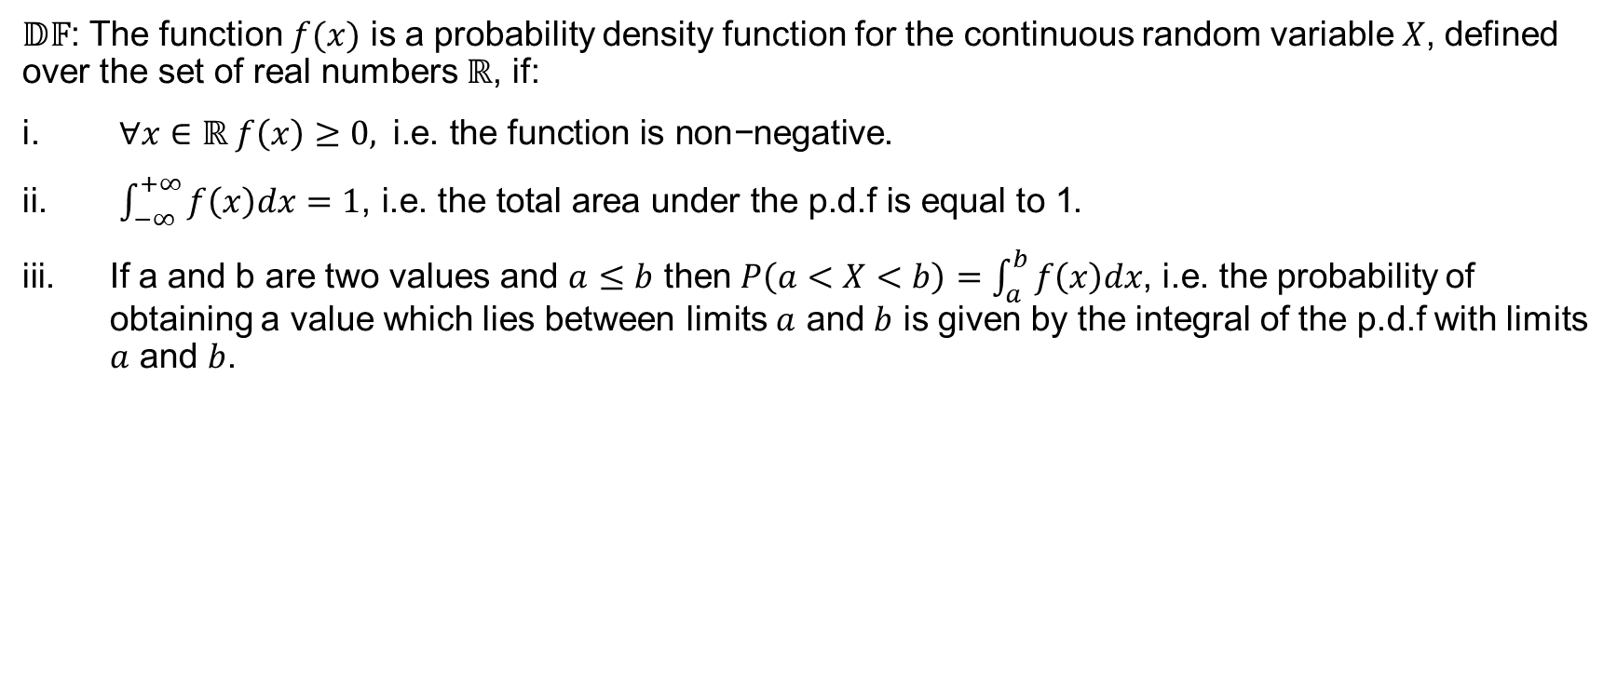
Definition
$𝔻𝔽$: The function $f(x)$ is a probability density function for the continuous random variable $X$, defined over the set of real numbers $ℝ$, if:
$∀x∈ℝ f\left(x\right)≥0, \text{i}\text{.}\text{e}\text{. }\text{the} \text{function} \text{is} \text{non}\text{−}\text{negative}$.
$\int_{−∞}^{+∞}{f\left(x\right)dx=1\text{, }\text{i}\text{.}\text{e}\text{. }\text{the} \text{total} \text{area} \text{under} \text{the} \text{p}\text{.}\text{d}\text{.}\text{f} \text{is} \text{equal} \text{to}\text{ 1}}$.
If a and b are two values and $a≤b$ then $P\left(a<X<b\right)=\int_{a}^{b}{f\left(x\right)dx}$, i.e. the probability of obtaining a value which lies between limits $a$ and $b$ is given by the integral of the p.d.f with limits $a$ and $b$.

Slide 32
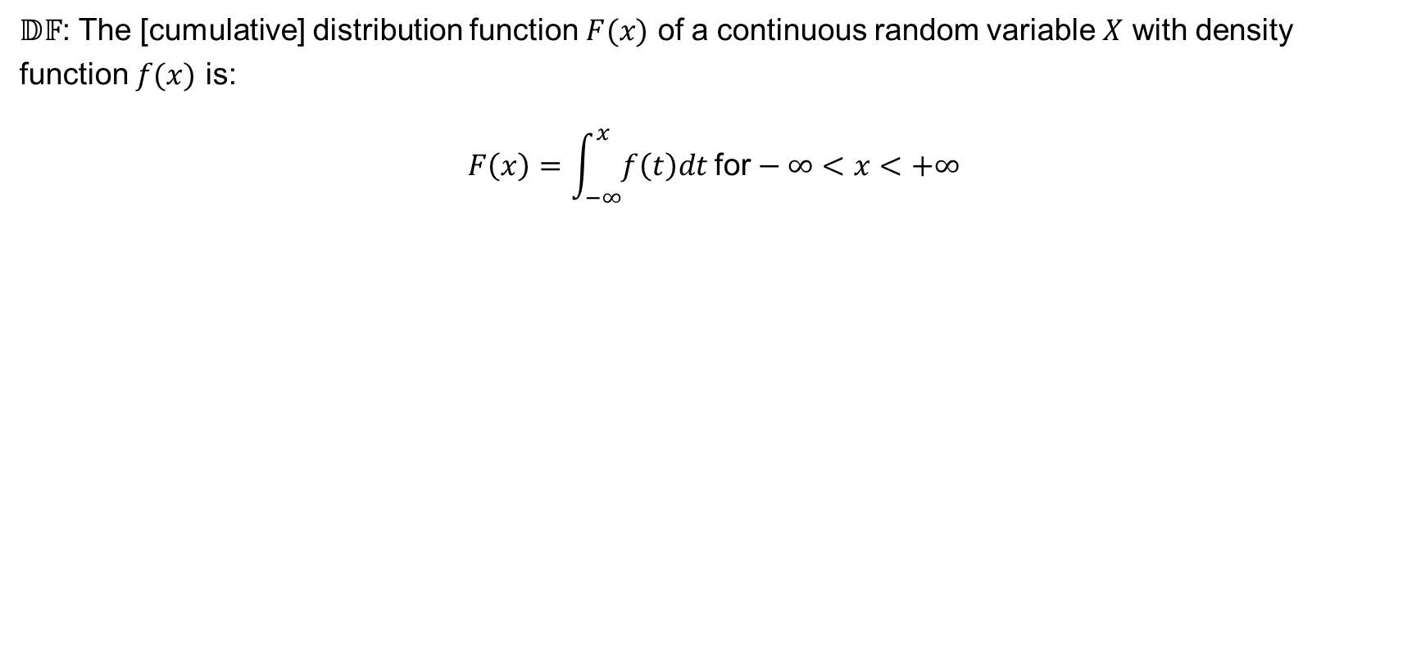
c.d.f of a continuous random variable
$𝔻𝔽$: The [cumulative] distribution function $F(x)$ of a continuous random variable $X$ with density function $f(x)$ is:
$$F\left(x\right)=\int_{−∞}^{x}{f\left(t\right)dt \text{for}−∞<x<+∞}$$

Slide 33
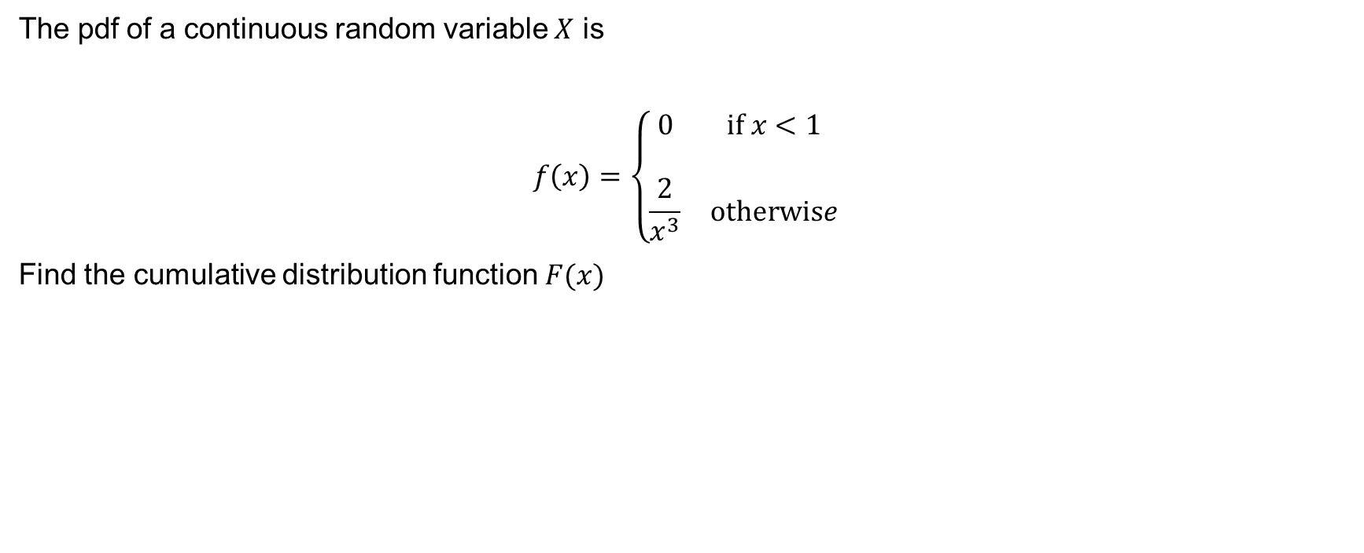
Worked Example
The pdf of a continuous random variable $X$ is
$$f\left(x\right)=\left\{\begin{matrix}0 & \text{if} x<1 \\ & \\ \frac{2}{x^{3}} & \text{otherwis}e\end{matrix}\right.$$
Find the cumulative distribution function $F(x)$

Slide 34
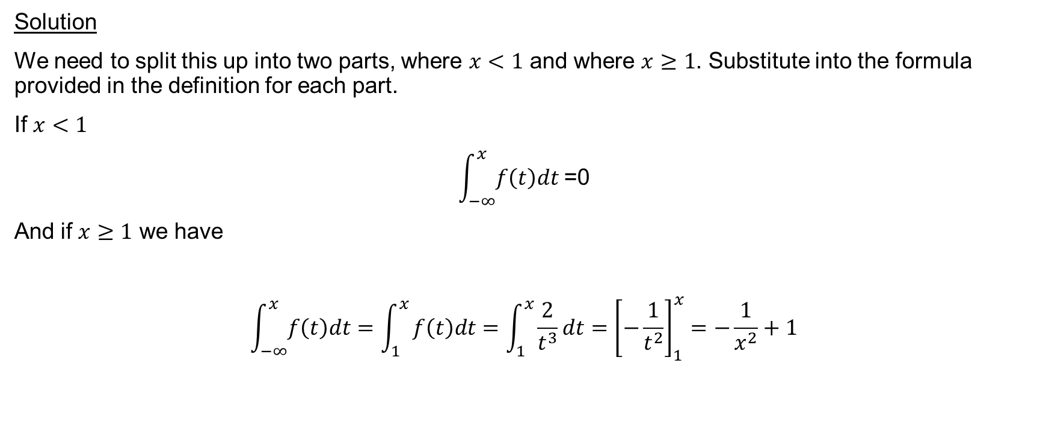
Worked Example (continued)
Solution
We need to split this up into two parts, where $x<1$ and where $x≥1$. Substitute into the formula provided in the definition for each part.
If $x<1$
$$\int_{−∞}^{x}{f\left(t\right)dt \text{=0}}$$
And if $x≥1$ we have
$$\int_{−∞}^{x}{f\left(t\right)dt}=\int_{1}^{x}{f\left(t\right)dt=\int_{1}^{x}{\frac{2}{t^{3}}dt={\left[−\frac{1}{t^{2}}\right]}_{1}^{x}=−\frac{1}{x^{2}}+1}}$$

Slide 35
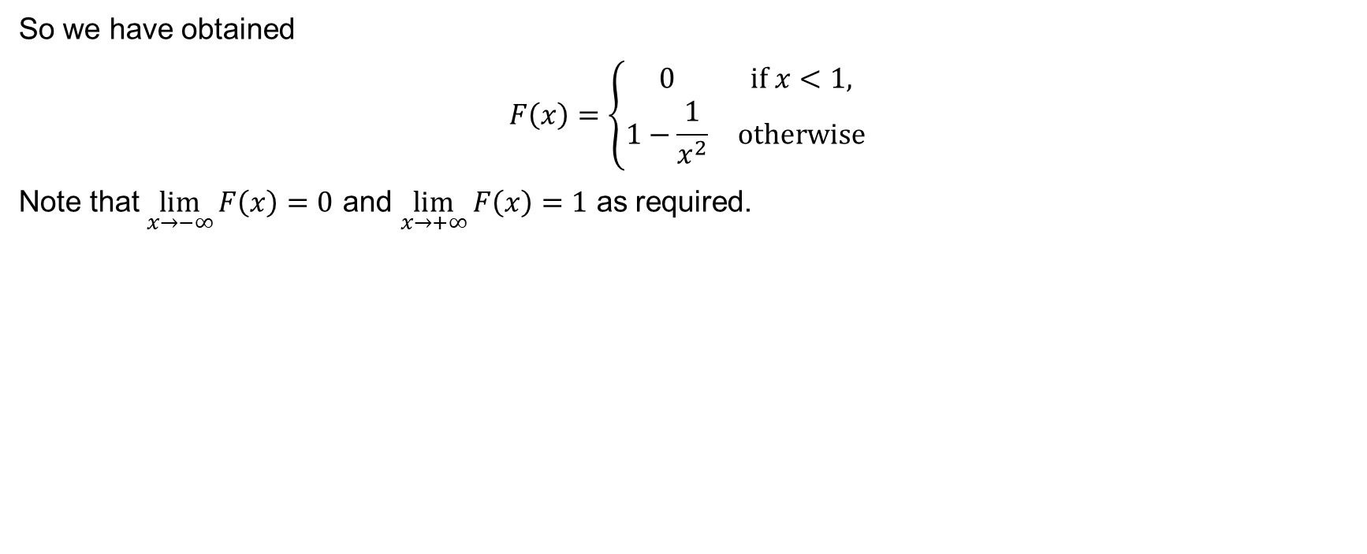
Worked Example (continued)
So we have obtained
$$F\left(x\right)=\left\{\begin{matrix}0 & \text{if} x<1, \\ 1−\frac{1}{x^{2}} & \text{otherwise}\end{matrix}\right.$$
Note that $\lim_{x→−∞}{F\left(x\right)=0}$ and $\lim_{x→+∞}{F\left(x\right)=1}$ as required.

Slide 36
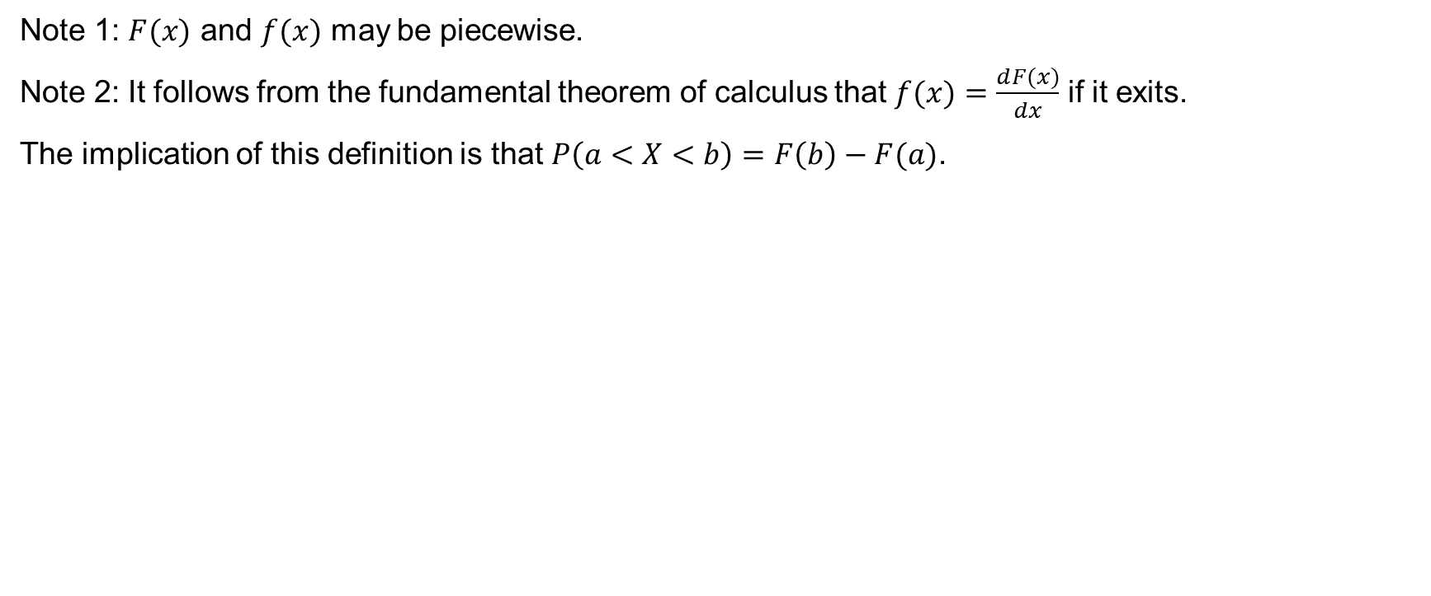
Comments
Note 1: $F(x)$ and $f(x)$ may be piecewise.
Note 2: It follows from the fundamental theorem of calculus that $f(x)=\frac{ⅆF(x)}{dx}$ if it exits.
The implication of this definition is that $P\left(a<X<b\right)=F\left(b\right)−F(a)$.

Slide 37
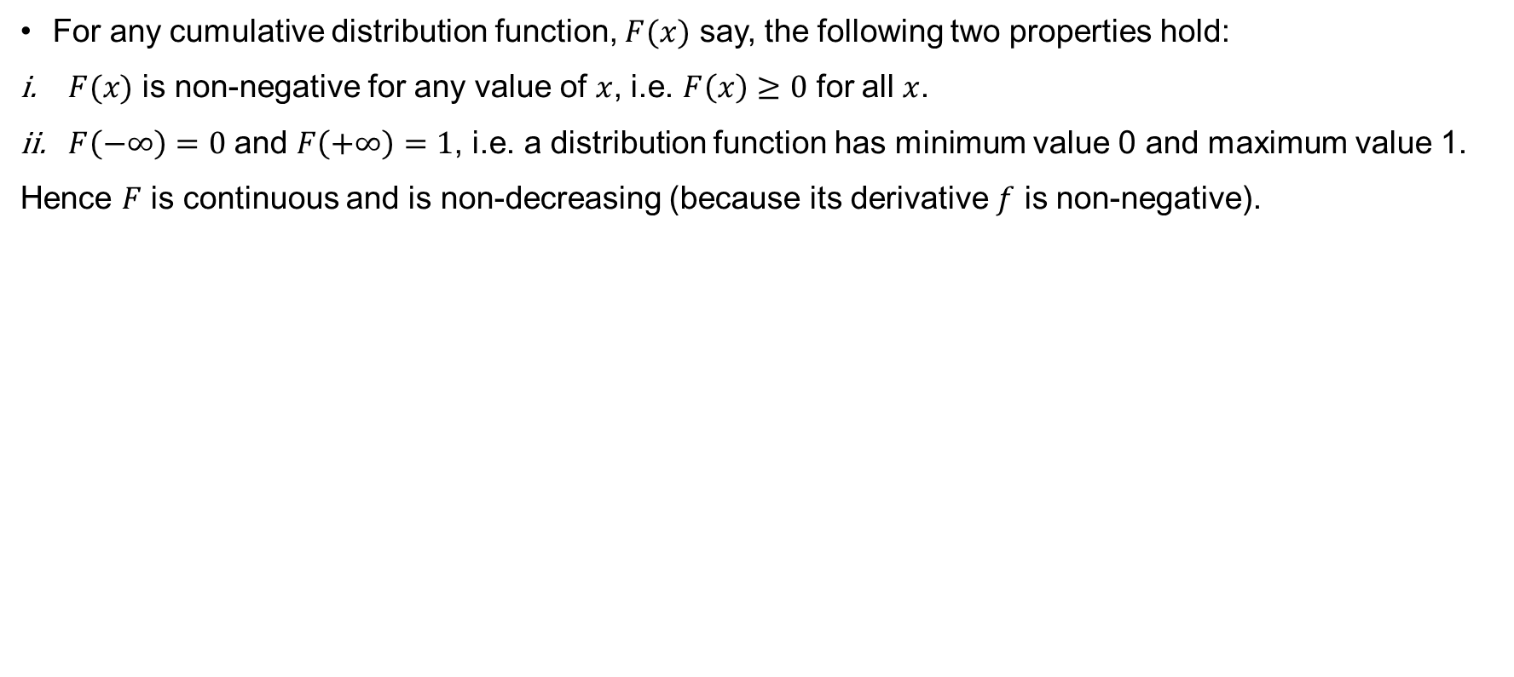
Properties of c.d.f
For any cumulative distribution function, $F(x)$ say, the following two properties hold:
$F(x)$ is non-negative for any value of $x$, i.e. $F\left(x\right)≥0$ for all $x$.
$F\left(−∞\right)=0$ and $F\left(+∞\right)=1$, i.e. a distribution function has minimum value 0 and maximum value 1.
Hence $F$ is continuous and is non-decreasing (because its derivative $f$ is non-negative).

Slide 38
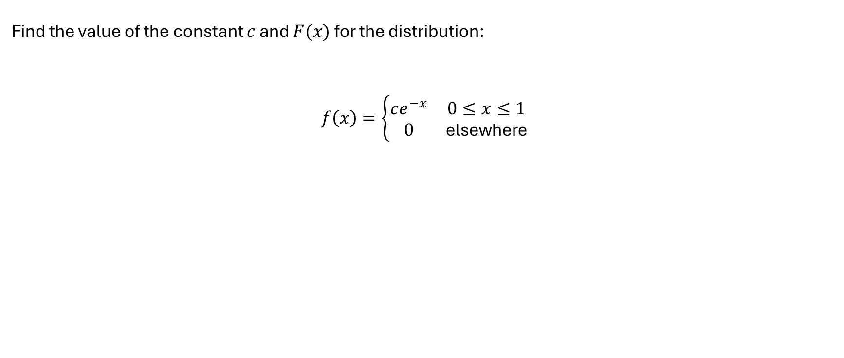
Example 6.5.
Find the value of the constant $c$ and $F(x)$for the distribution:
$$f\left(x\right)=\left\{\begin{matrix}ce^{−x} & 0≤x≤1 \\ 0 & \text{elsewhere}\end{matrix}\right.$$

Slide 39
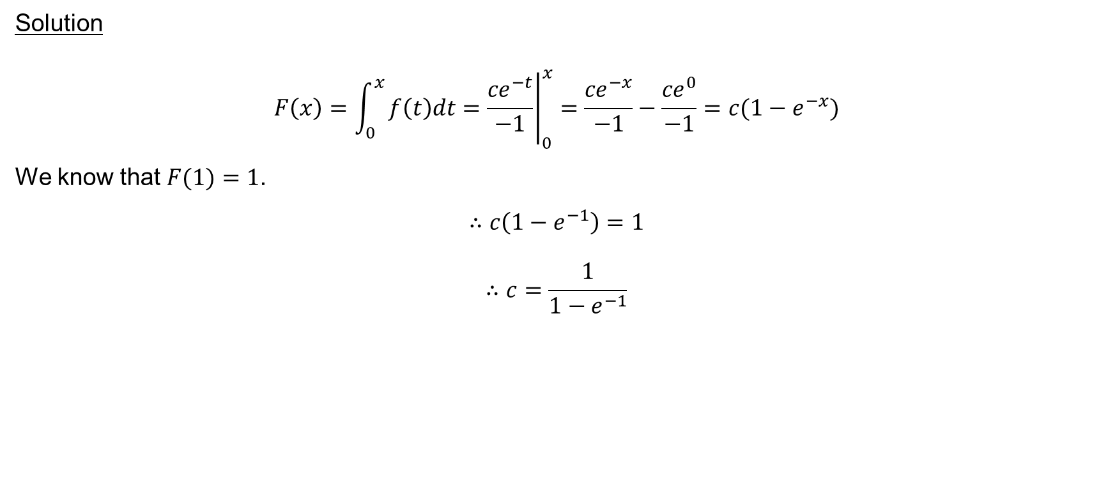
Example 6.5 (continued)
Solution
$$F\left(x\right)=\int_{0}^{x}{f\left(t\right)dt={\left.\frac{{ce}^{−t}}{−1}\right|}_{0}^{x}=\frac{{ce}^{−x}}{−1}−\frac{{ce}^{0}}{−1}=c(1−e^{−x})}$$
We know that $F(1)=1$.
$$∴c\left(1−e^{−1}\right)=1$$
$$∴c=\frac{1}{1−e^{−1}}$$

Slide 40
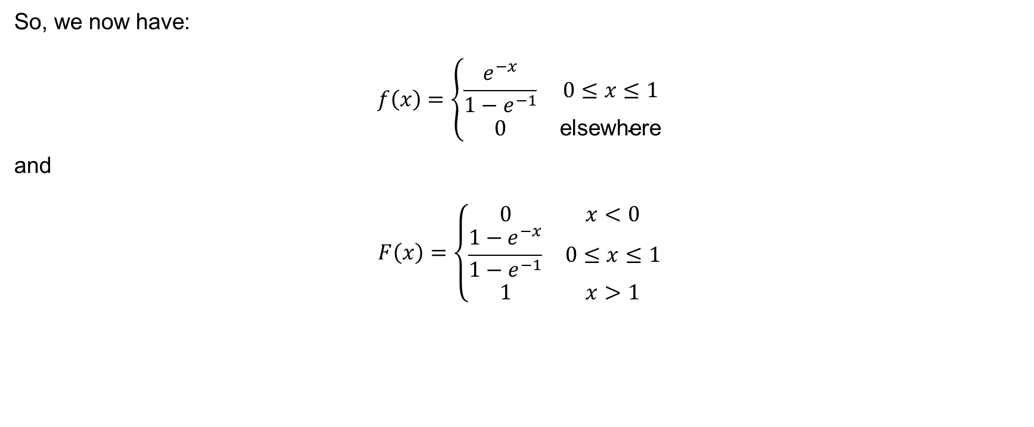
Example 6.5 (continued)
So, we now have:
$$f\left(x\right)=\left\{\begin{matrix}\frac{e^{−x}}{1−e^{−1}} & 0≤x≤1 \\ 0 & \text{elsewhere}\end{matrix}\right.$$
and
$$F\left(x\right)=\left\{\begin{matrix}0 & x<0 \\ \frac{1−e^{−x}}{1−e^{−1}} & 0≤x≤1 \\ 1 & x>1\end{matrix}\right.$$

Slide 41
Comments
Note 1: If we were not required to find the c.d.f then we would have integrated over the full range of the distribution and equated this to 1.
Note 2: If the distribution is piecewise then deal with each piece individually.

Slide 42
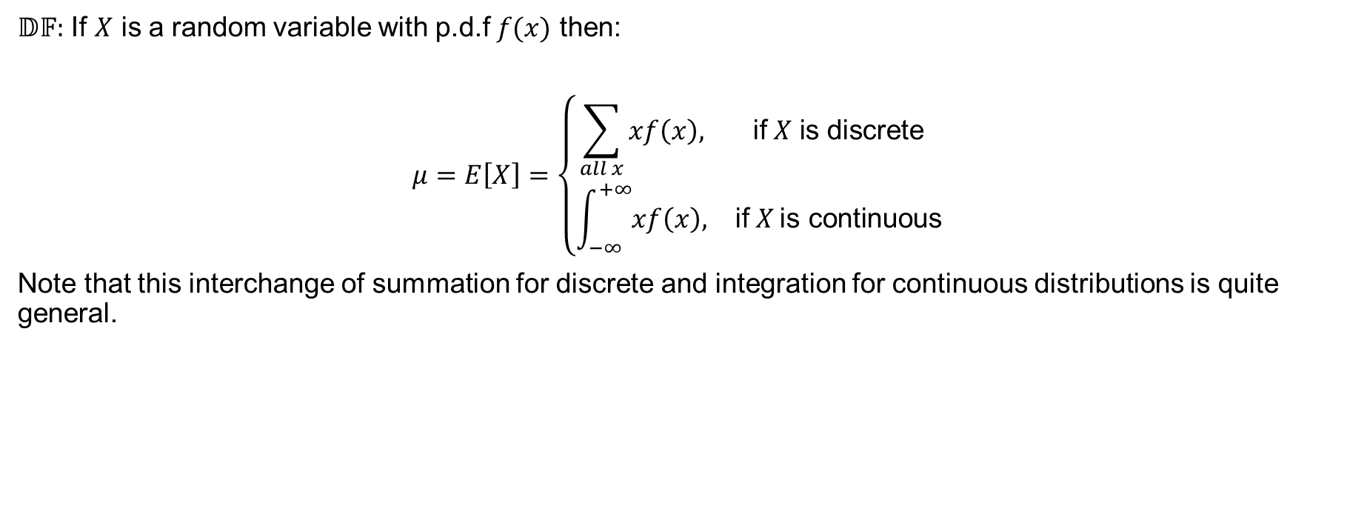
Mean or Expected value
$𝔻𝔽:$ If $X$ is a random variable with p.d.f $f(x)$ then:
$$μ=E\left[X\right]=\left\{\begin{matrix}\sum_{all x}{xf\left(x\right),} & \text{if} X \text{is} \text{discrete} \\ \int_{−∞}^{+∞}{xf\left(x\right),} & \text{if} X \text{is} \text{continuous}\end{matrix}\right.$$
Note that this interchange of summation for discrete and integration for continuous distributions is quite general.

Slide 43
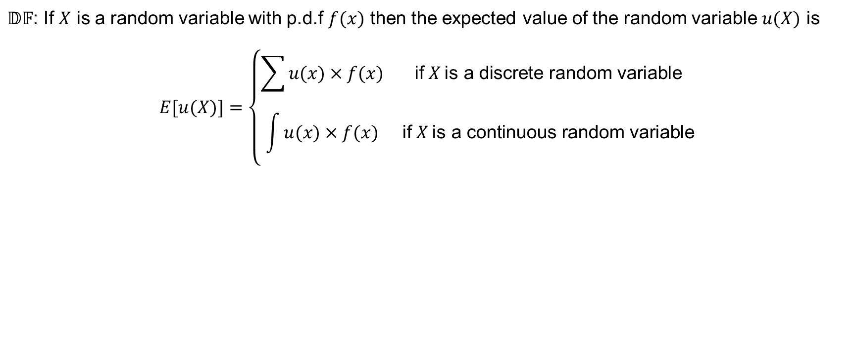
Expected value of a random variable
$𝔻𝔽$: If $X$ is a random variable with p.d.f $f(x)$ then the expected value of the random variable $u(X)$ is
$$E[u(X)]=\left\{\begin{matrix}\sum{u(x)×f(x)} & \text{if} X \text{is} \text{a} \text{discrete} \text{random} \text{variable} \\ \int{u(x)×f(x)} & \text{if} X \text{is} \text{a} \text{continuous} \text{random} \text{variable}\end{matrix}\right.$$

Slide 44
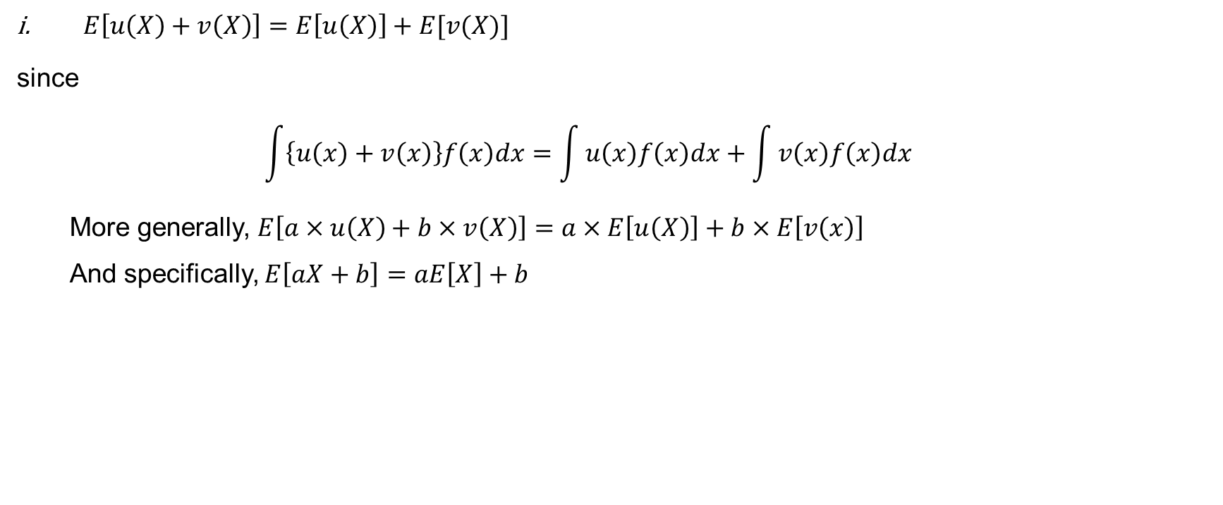
Properties of expected values
$E\left[u\left(X\right)+v\left(X\right)\right]=E\left[u\left(X\right)\right]+E[v(X)]$
since
$$\int{\left\{u\left(x\right)+v\left(x\right)\right\}f\left(x\right)dx=\int{u\left(x\right)f\left(x\right)dx}}+\int{v\left(x\right)f\left(x\right)dx}$$
More generally, $E\left[a×u\left(X\right)+b×v\left(X\right)\right]=a×E\left[u\left(X\right)\right]+b×E\left[v\left(x\right)\right]$
And specifically, $E\left[aX+b\right]=aE\left[X\right]+b$

Slide 45
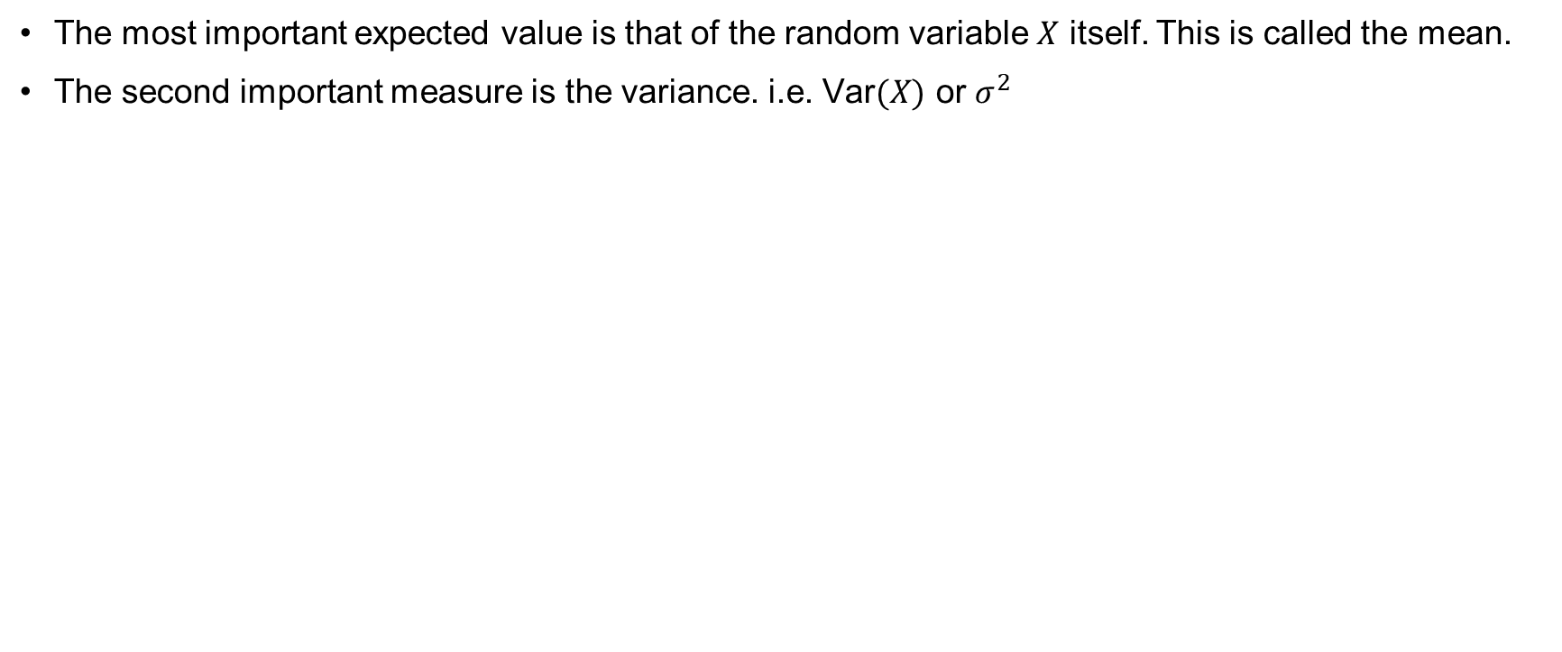
Comments
The most important expected value is that of the random variable $X$ itself. This is called the mean.
The second important measure is the variance. i.e. $\text{Var}(X)$ or $σ^{2}$

Slide 46
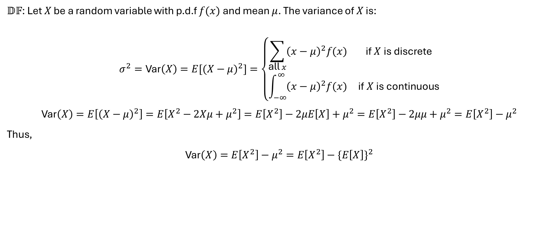
Variance
$𝔻𝔽$: Let $X$ be a random variable with p.d.f $f(x)$ and mean $μ$. The variance of $X$ is:
$$σ^{2}=\text{Var}\left(X\right)=E[{(X−μ)}^{2}]=\left\{\begin{matrix}\sum_{\text{all} x}{{\left(x−μ\right)}^{2}f(x)} & \text{if} X \text{is} \text{discrete} \\ \int_{−∞}^{∞}{{\left(x−μ\right)}^{2}f(x)} & \text{if} X \text{is} \text{continuous}\end{matrix}\right.$$
$$\text{Var}\left(X\right)=E\left[{\left(X−μ\right)}^{2}\right]=E\left[X^{2}−2Xμ+μ^{2}\right]=E\left[X^{2}\right]−2μE\left[X\right]+μ^{2}=E\left[X^{2}\right]−2μμ+μ^{2}=E\left[X^{2}\right]−μ^{2}$$
Thus,
$$\text{Var}\left(X\right)=E\left[X^{2}\right]−μ^{2}=E\left[X^{2}\right]−{\{E\left[X\right]\}}^{2}$$

Slide 47
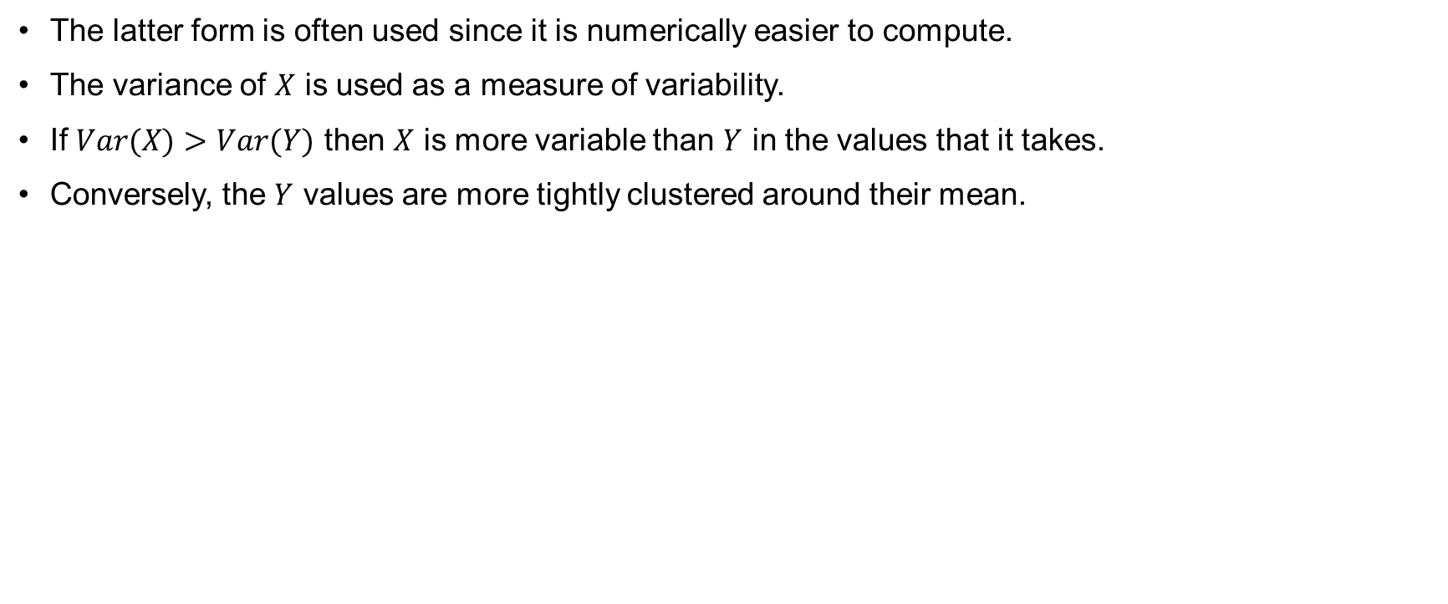
Comments
The latter form is often used since it is numerically easier to compute.
The variance of $X$ is used as a measure of variability.
If $Var(X)>Var(Y)$ then $X$ is more variable than $Y$ in the values that it takes.
Conversely, the $Y$ values are more tightly clustered around their mean.

Slide 48
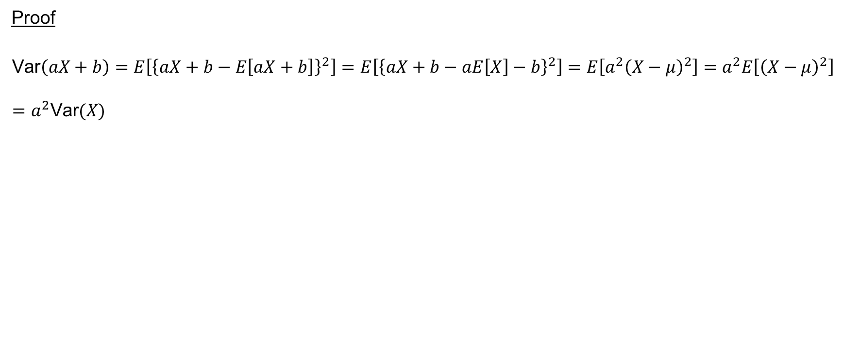
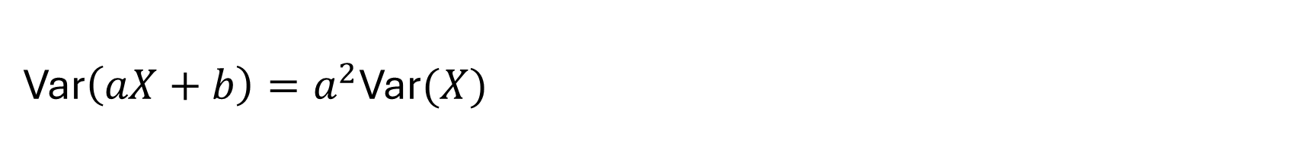
$\text{Var}\left(aX+b\right)=a^{2}\text{Var}(X)$
Proof
$$\text{Var}\left(aX+b\right)=E\left[{\left\{aX+b−E\left[aX+b\right]\right\}}^{2}\right]=E\left[{\left\{aX+b−aE\left[X\right]−b\right\}}^{2}\right]=E\left[a^{2}{\left(X−μ\right)}^{2}\right]=a^{2}E\left[{\left(X−μ\right)}^{2}\right]=a^{2}\text{Var}(X)$$

Slide 49
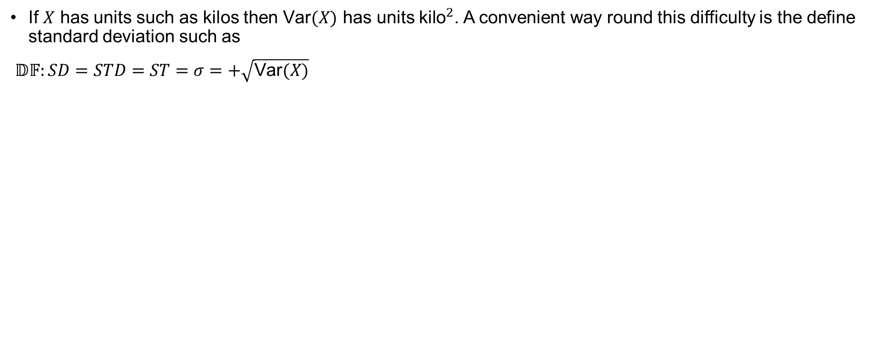
Standard Deviation
If $X$ has units such as kilos then $\text{Var}(X)$ has units ${\text{kilo}}^{2}$. A convenient way round this difficulty is the define standard deviation such as
$𝔻𝔽:SD=STD=ST=σ=+\sqrt{\text{Var}(X)}$

Slide 50
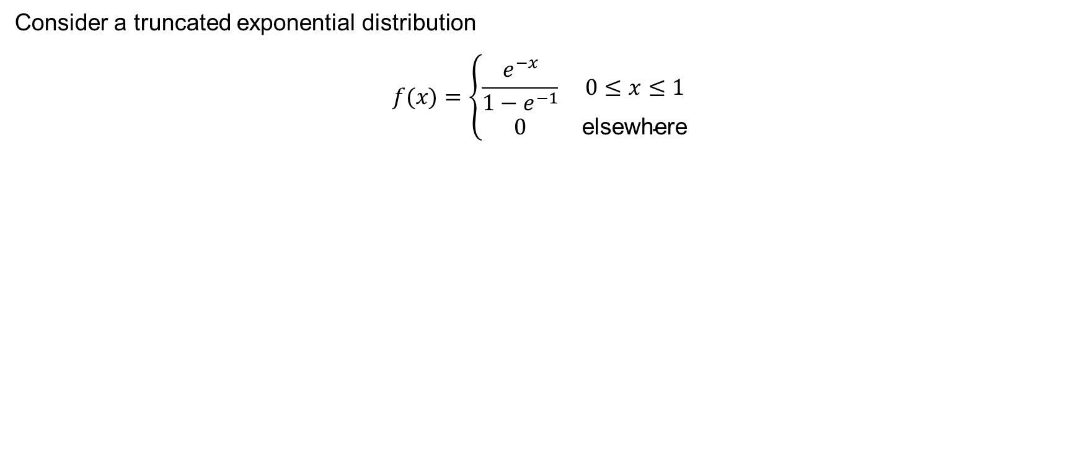
Example 6.6
Consider a truncated exponential distribution
$$f(x)=\left\{\begin{matrix}\frac{e^{−x}}{1−e^{−1}} & 0≤x≤1 \\ 0 & \text{elsewhere}\end{matrix}\right.$$

Slide 51
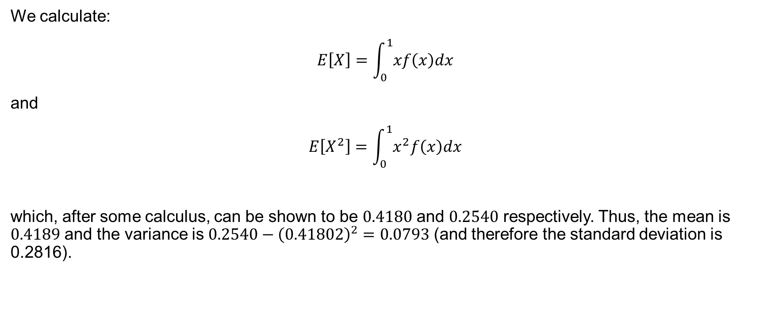
Example 6.6 (continued)
We calculate:
$$E\left[X\right]=\int_{0}^{1}{xf\left(x\right)dx}$$
and
$$E\left[X^{2}\right]=\int_{0}^{1}{x^{2}f\left(x\right)dx}$$
which, after some calculus, can be shown to be $0.4180$ and $0.2540$ respectively. Thus, the mean is $0.4189$ and the variance is $0.2540−{\left(0.41802\right)}^{2}=0.0793$ (and therefore the standard deviation is 0.2816).

Slide 52
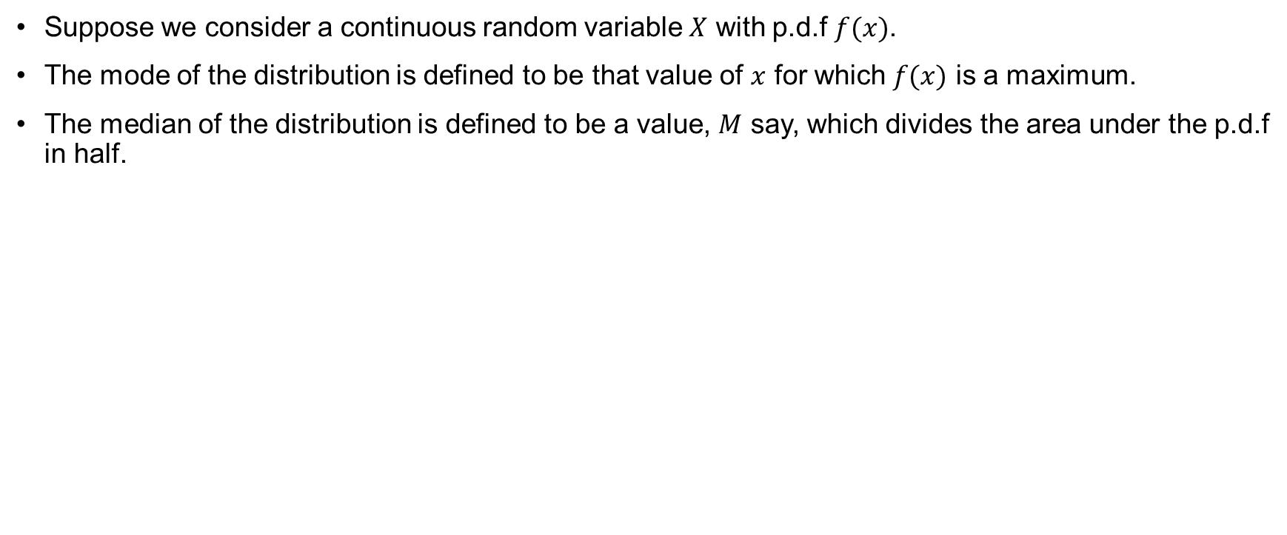
The median and the mode of a continuous distribution
Suppose we consider a continuous random variable $X$ with p.d.f $f(x)$.
The mode of the distribution is defined to be that value of $x$ for which $f(x)$ is a maximum.
The median of the distribution is defined to be a value, $M$ say, which divides the area under the p.d.f in half.

Slide 53
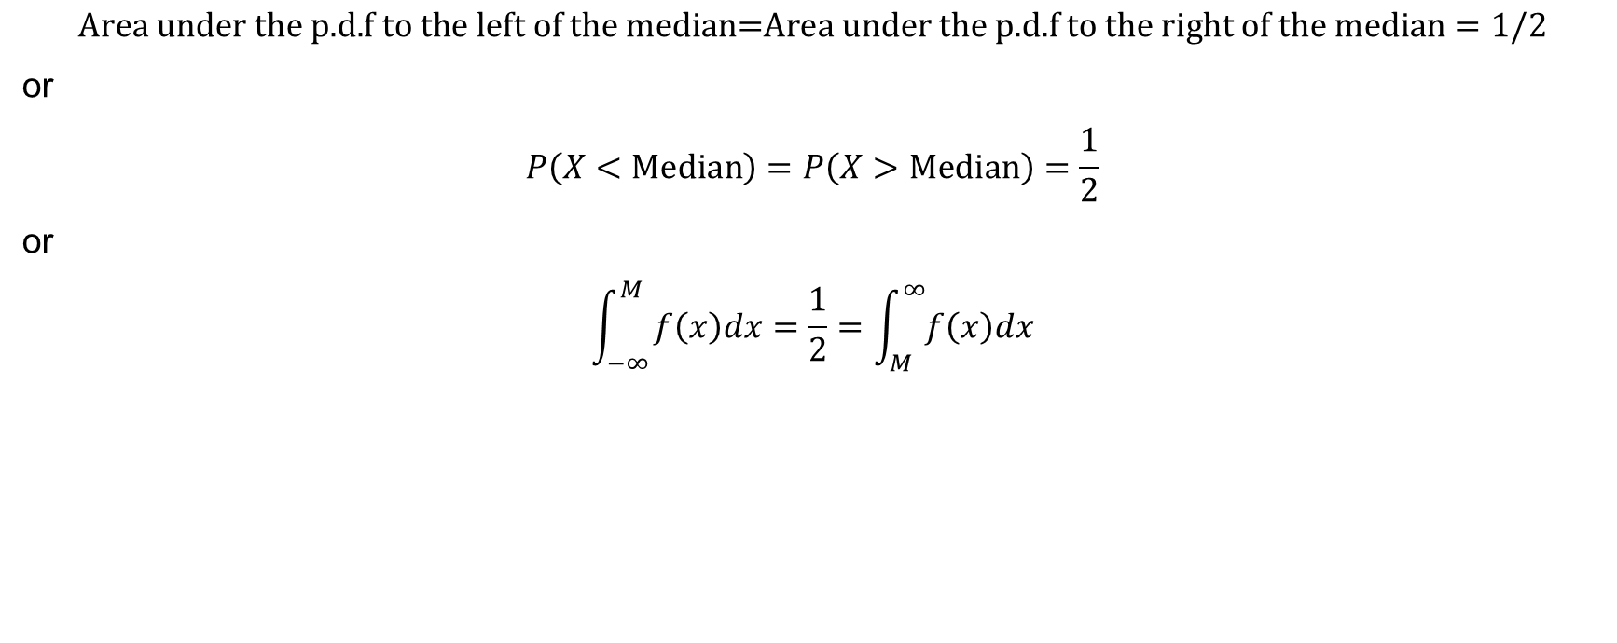
The median and the mode of a continuous distribution (continued)
$$\text{Area} \text{under} \text{the} \text{p}\text{.}\text{d}\text{.}\text{f} \text{to} \text{the} \text{left} \text{of} \text{the} \text{median}\text{=}\text{Area} \text{under} \text{the} \text{p}\text{.}\text{d}\text{.}\text{f} \text{to} \text{the} \text{right} \text{of} \text{the} \text{median}=1/2$$
or
$$P\left(X<\text{Median}\right)=P\left(X>\text{Median}\right)=\frac{1}{2}$$
or
$$\int_{−∞}^{M}{f\left(x\right)dx=\frac{1}{2}=\int_{M}^{∞}{f\left(x\right)dx}}$$

Slide 54
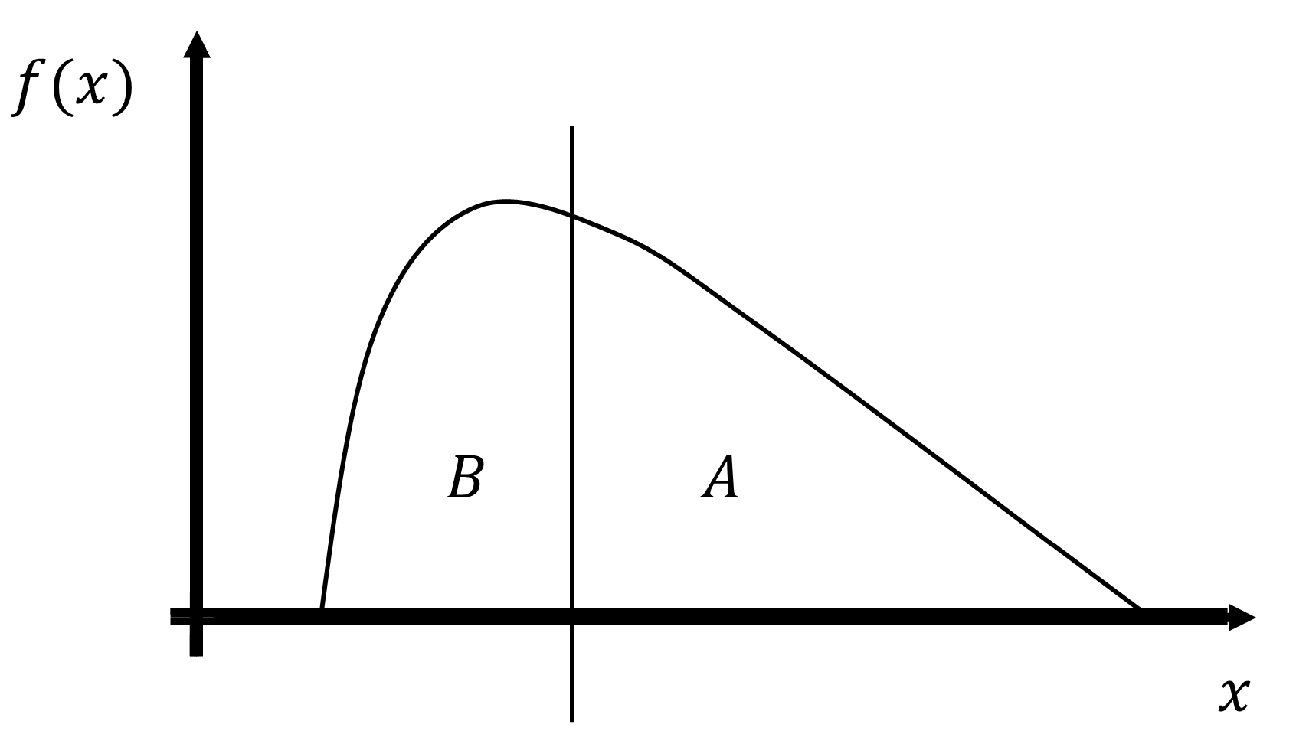
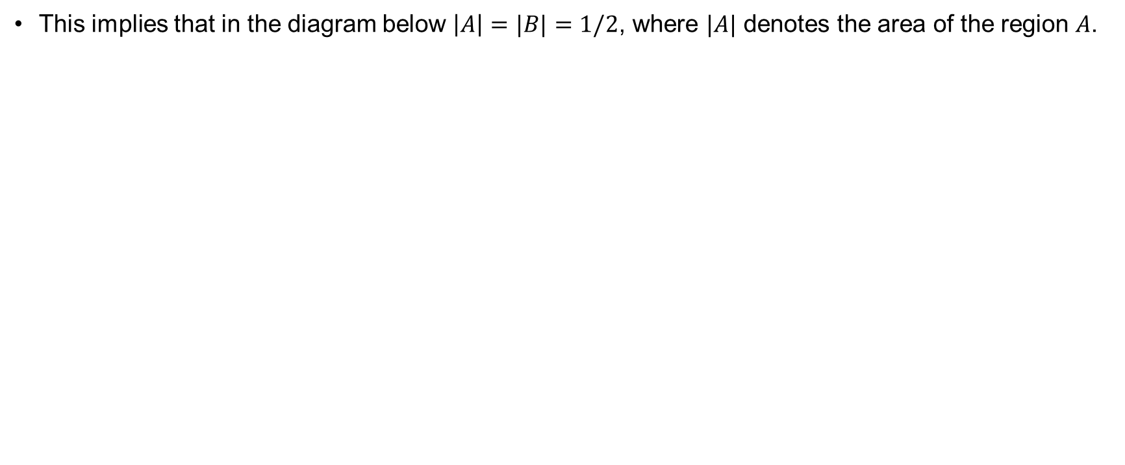
The median and the mode of a continuous distribution (continued)
This implies that in the diagram below $\left|A\right|=|B|=1/2$, where $|A|$ denotes the area of the region $A$.

Slide 55

Example 6.7
Given
$f\left(x\right)=\left\{\begin{matrix}kx(1−x) & 0<x<1 \\ 0 & \text{elsewhere}\end{matrix}\right.$
Find $k$.
Calculate the mean, variance and standard deviation.
Calculate the median and mode.

Slide 56

Example 6.7 (continued)
Solution to part i.
We know that the integral of the p.d.f is 1 for any valid p.d.f and hence
$$\int_{−∞}^{+∞}{f\left(x\right)dx}=\int_{0}^{1}{kx\left(1−x\right)dx}=k\left\{\int_{0}^{1}{kx\left(1−x\right)dx}\right\}=1$$
Thus,
$$k{\left.\frac{x^{2}}{2}−\frac{x^{3}}{3}\right|}_{0}^{1}=1$$
$$\frac{k}{6}=1$$
Hence, $k=6$

Slide 57

Example 6.7 (continued)
Solution to part ii.
Substituting $k$ into initial formula for the p.d.f, the mean of the distribution is given by:
$$μ=E\left[X\right]=\int_{−∞}^{+∞}{xf\left(x\right)dx=\int_{0}^{1}{x6x(1−x)dx}=6{\left.\frac{x^{3}}{3}−\frac{x^{4}}{4}\right|}_{0}^{1}=\frac{6}{12}=\frac{1}{2}}$$
The variance of the distribution is given by:
$$σ^{2}=\text{Var}\left(X\right)=E\left[X^{2}\right]−{\left\{E\left[X\right]\right\}}^{2}=\int_{0}^{1}{x^{2}6x\left(1−x\right)dx}−{\left\{\frac{1}{2}\right\}}^{2}=6{\left.\frac{x^{4}}{4}−\frac{x^{5}}{5}\right|}_{0}^{1}−\frac{1}{4}=\frac{6}{20}−\frac{1}{4}=\frac{1}{20}$$
The standard deviation is therefore given by $\sqrt{\frac{1}{20}}$

Slide 58

Example 6.7 (continued)
Solution to part iii.
The median is that value, M say, for which
$$\int_{0}^{M}{f\left(x\right)dx=\int_{0}^{M}{6x(1−x)dx}=\frac{1}{2}}$$

Slide 59

Example 6.7 (continued)
Therefore,
$$6{\left.\left\{\frac{x^{2}}{2}−\frac{x^{3}}{3}\right\}\right|}_{0}^{M}=\frac{1}{2}$$
i.e.
$$6\left\{\frac{M^{2}}{2}−\frac{M^{3}}{3}\right\}=3M^{2}−2M^{3}=M^{2}\left[3−2M\right]=\frac{1}{2}$$
The solution of to this equation is $M=1/2$, i.e. the median is ½.

Slide 60

Mode
Finally, the mode of the distribution is obtained by finding the value of $x$ for which the p.d.f is a maximum.
In this case, because the function is well behaved, this can be done by differentiating the p.d.f with respect to $x$ and finding this value of $x$ for which the derivative is 0 – in order to find the value of $x$ for which the p.d.f is a maximum.
Of course, we also have to check that the value obtained really is a maximum and not a minimum or point of inflexion.

Slide 61

Mode for Example 6.7
In this case,
$$\frac{df(x)}{dx}=\frac{d\{6x(1−x)\}}{dx}=\frac{d\{6x−6x^{2}\}}{dx}=6−12x$$
Setting the derivative equal to zero, we obtain $6−12x=0$, i.e. $6=12x$ and hence $x=1/2$.
To check that this is truly a maximum we note that the second derivative of the p.d.f is -12 which confirms our value of $x=1/2$ as being the maximum value of the p.d.f.

